Slide 1
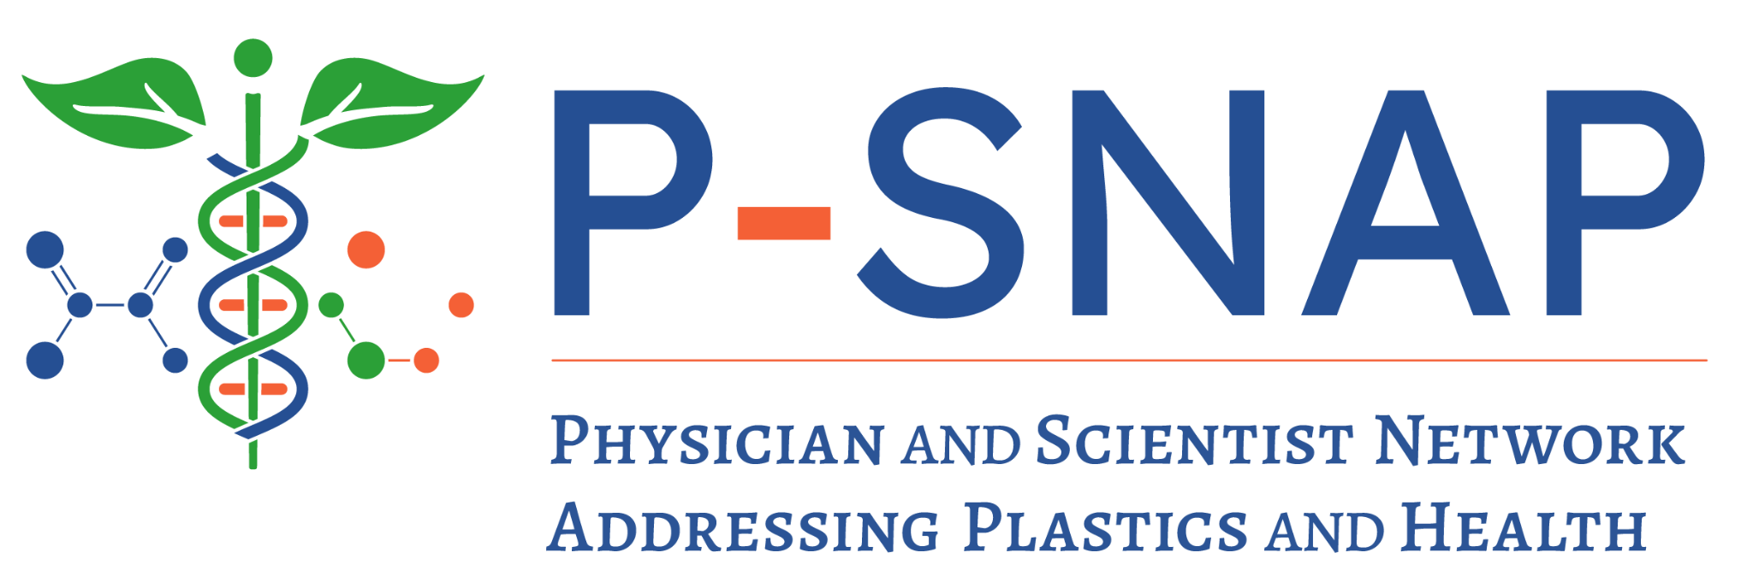
The Race to Research:
Plastic, Microplastics,
and Human Health
Megan J. Wolff, PhD MPH
Executive Director
megan@psnap.org
Jan 21, 2025

Slide 2
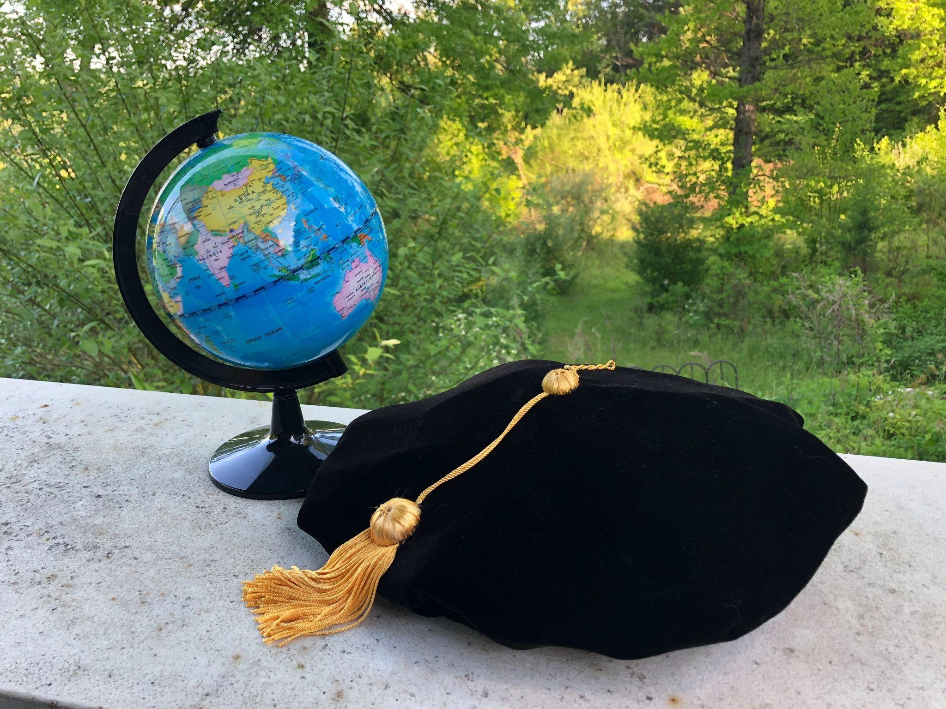
History is not inevitable.
Problems that are not inevitable are solvable.

Slide 3
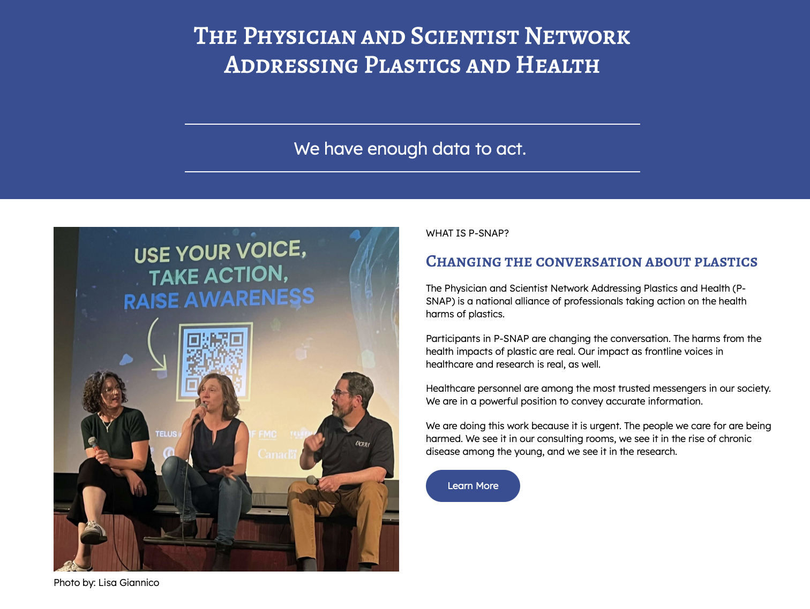
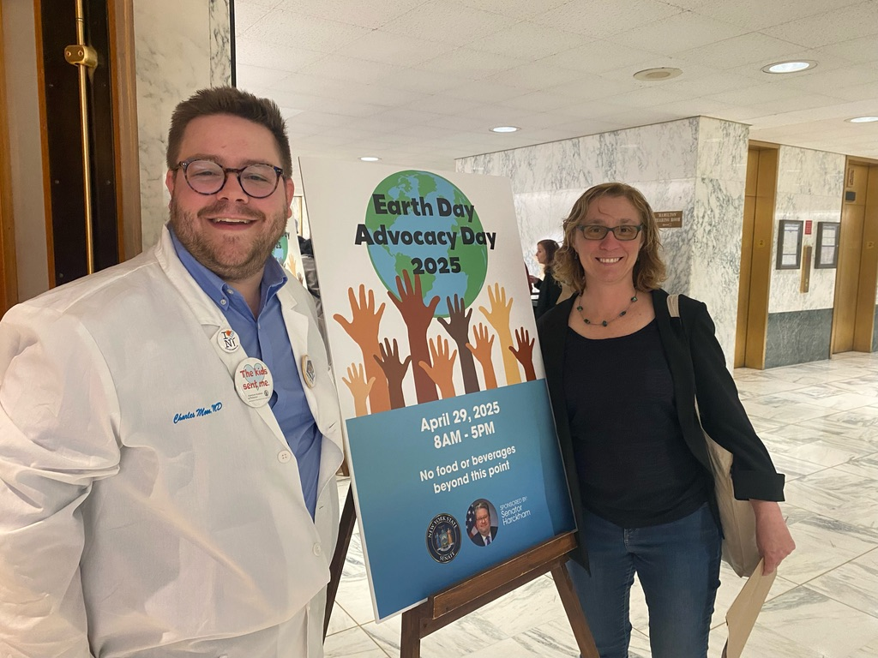

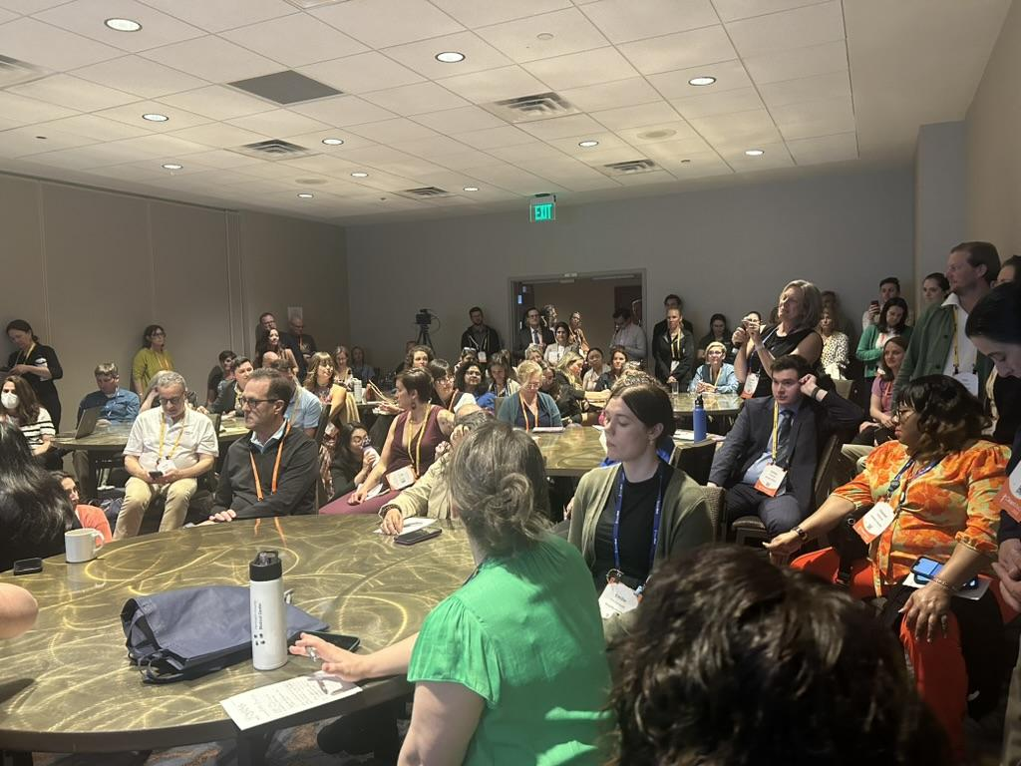
* 130+ Participants * 27 Specialties * 23 States
Notes:
You can join this fight. Healthcare personnel are regularly needed to testify to local legislatures and write letters to the editor supporting such bans.

Slide 4
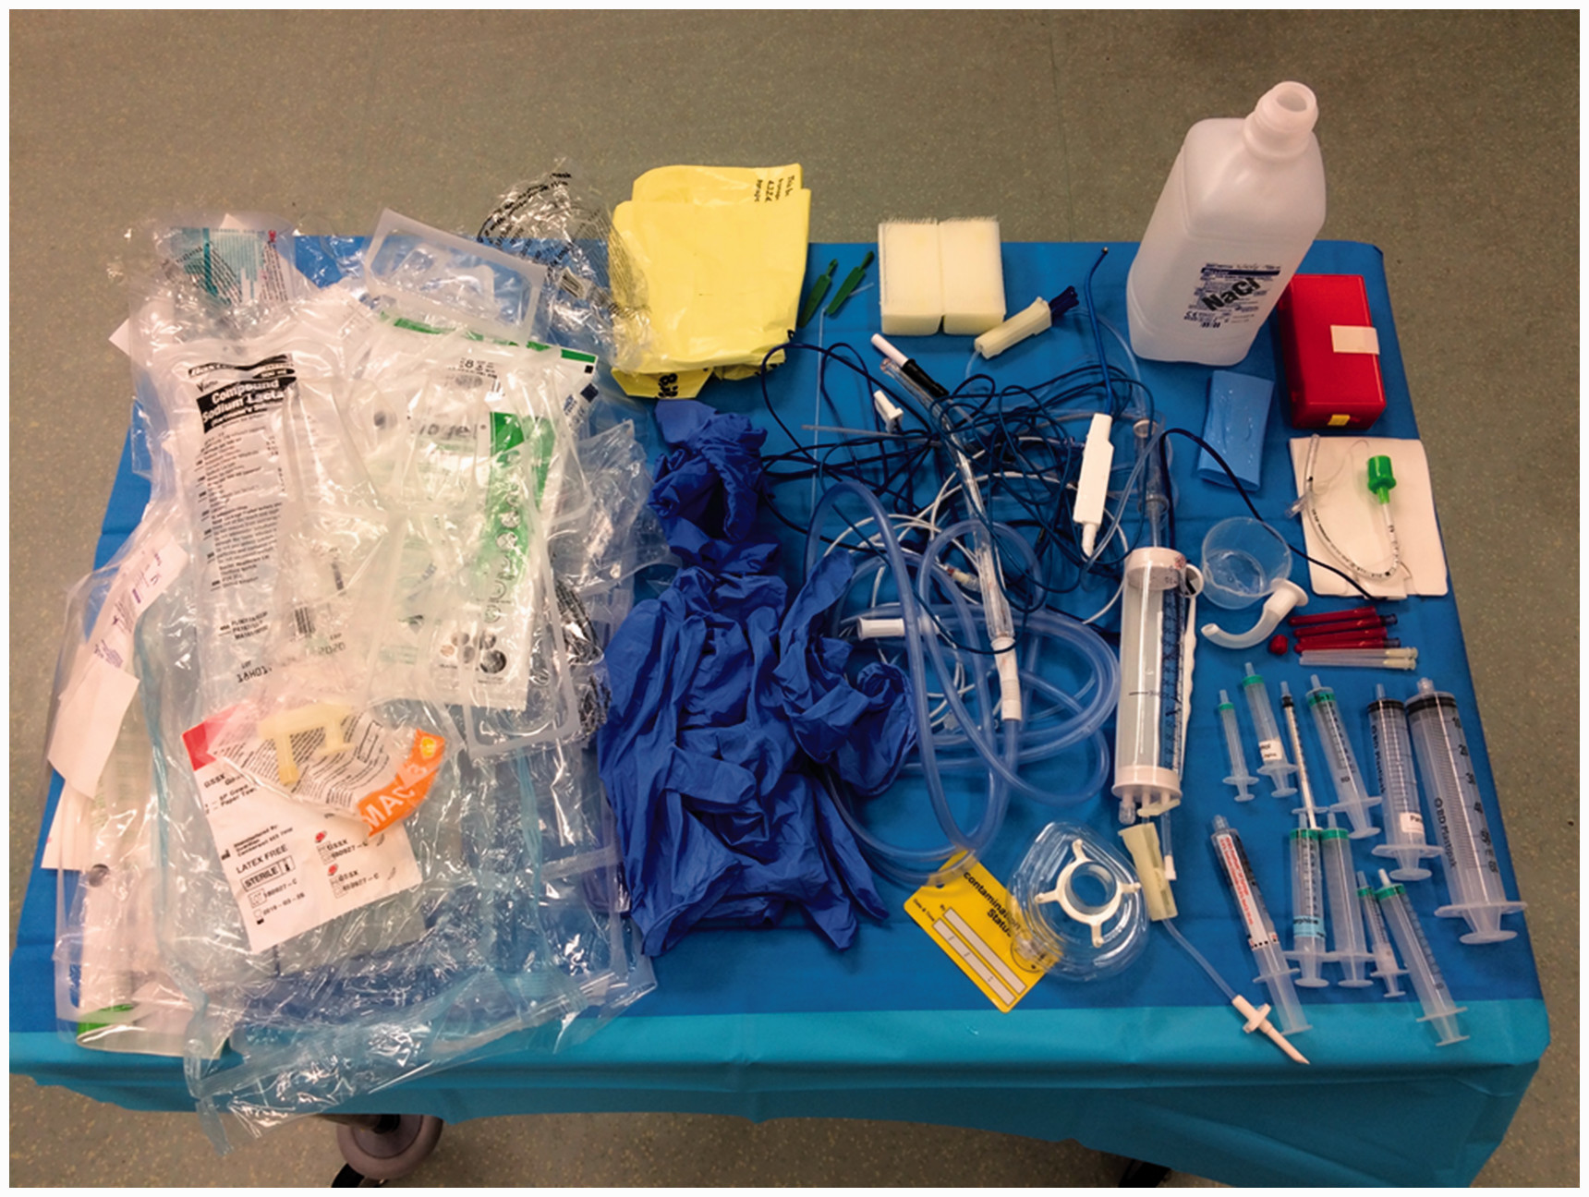
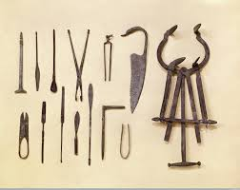
Plastics revolutionized healthcare
Slide by Hilary Ong, MD
Notes:
Plastics revolutionized medicine, since the mid 1900s , making our operations more convenient and efficient
Now decades later, our Healthcare is wrapped in plastic. Challenge: think about a day at work in clinic, hospital,pharmacy, lab, How much plastic wrapping, plastic materials do you handle?
We are never going to get rid of plastics, but we need to use it more wisely , dramatically reducing our use especially single use plastics because it causes potential negative patient and population health harms.
Now our health care industry relies heavily on plastic materials due to their low cost, durability, flexibility, and sterility.

Slide 5
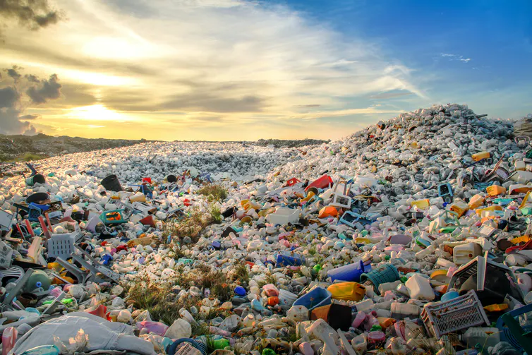
Nearly 10 billion tons of plastic have been produced since 1950
Notes:
One of the most amazing aspects of the plastics crisis is how recent it is.
Of the nearly 10 billion ton of plastic in existence today, approximately half was manufactured in the last 15 years.
You did not generate or purchase 10 billion tons of plastic. This is not your fault. You are here to be part of the solution.

Slide 6
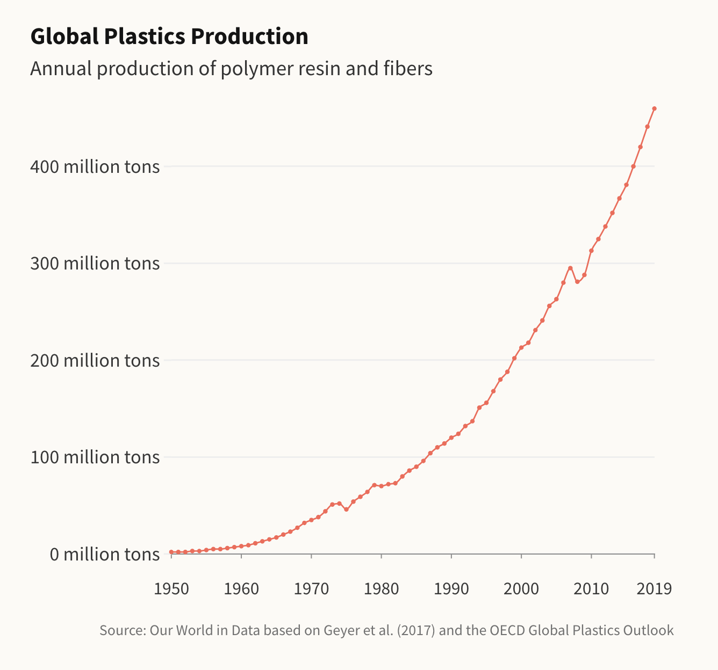
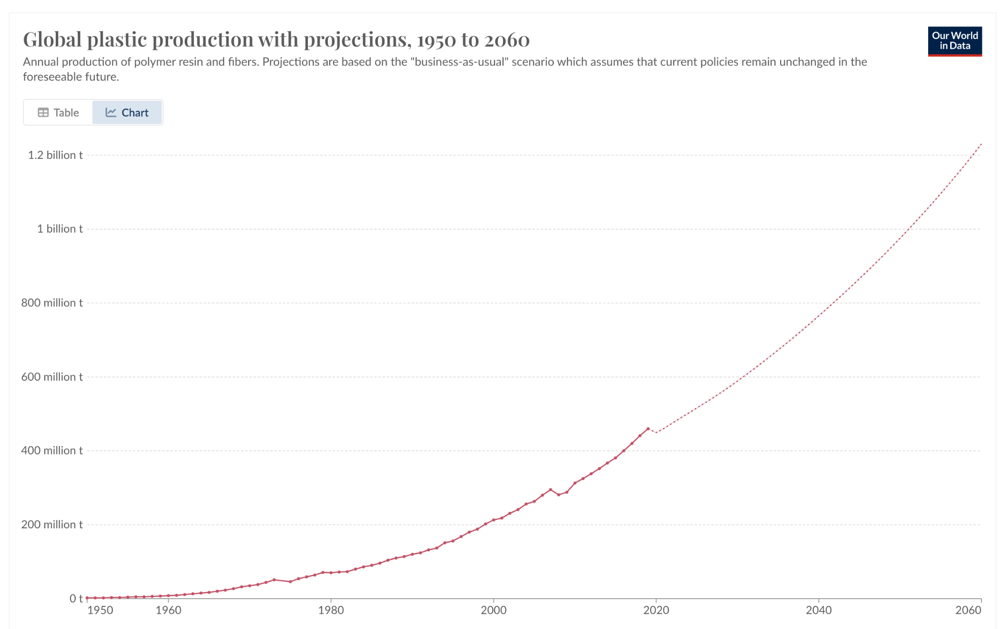
And is on track to triple by 2060.
Plastic production doubles approximately every 14 years.
Notes:
The human population has tripled since 1950; plastic production increased 70-fold. And we are on track to double production again by 2050.
This graph shows plastic production over much of the past century. If you look carefully, you might notice something interesting: Half of all the plastic ever produced was created in the past 15-20 years. That is alarming, but it is also grounds for hope. This problem is incredibly recent. Think about where you were in 2005. It is very easy to imagine a world without this level of plastic. It is also easy to identify how things came to be this way, and how to change them.
So how did things come to be this way? Let’s take a moment to go back to the beginning.

Slide 7
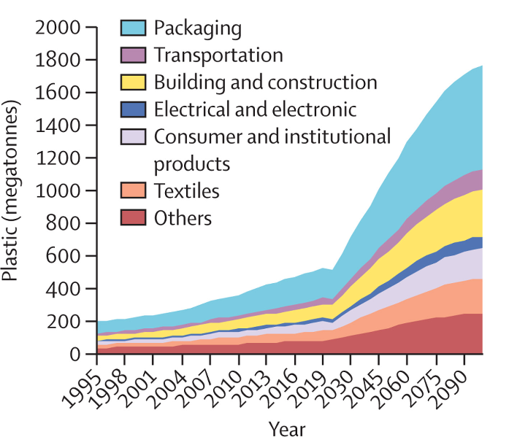
Annual Plastic Production
Image from: Landrigan et al (Aug 2025). The Lancet, DOI: 10.1016/S0140-6736(25)01447-3
Notes:
Single-use items account for an estimated 35–40% of current plastic output and contribute disproportionately to plastic waste, accounting an estimated 65% of discarded plastics

Slide 8
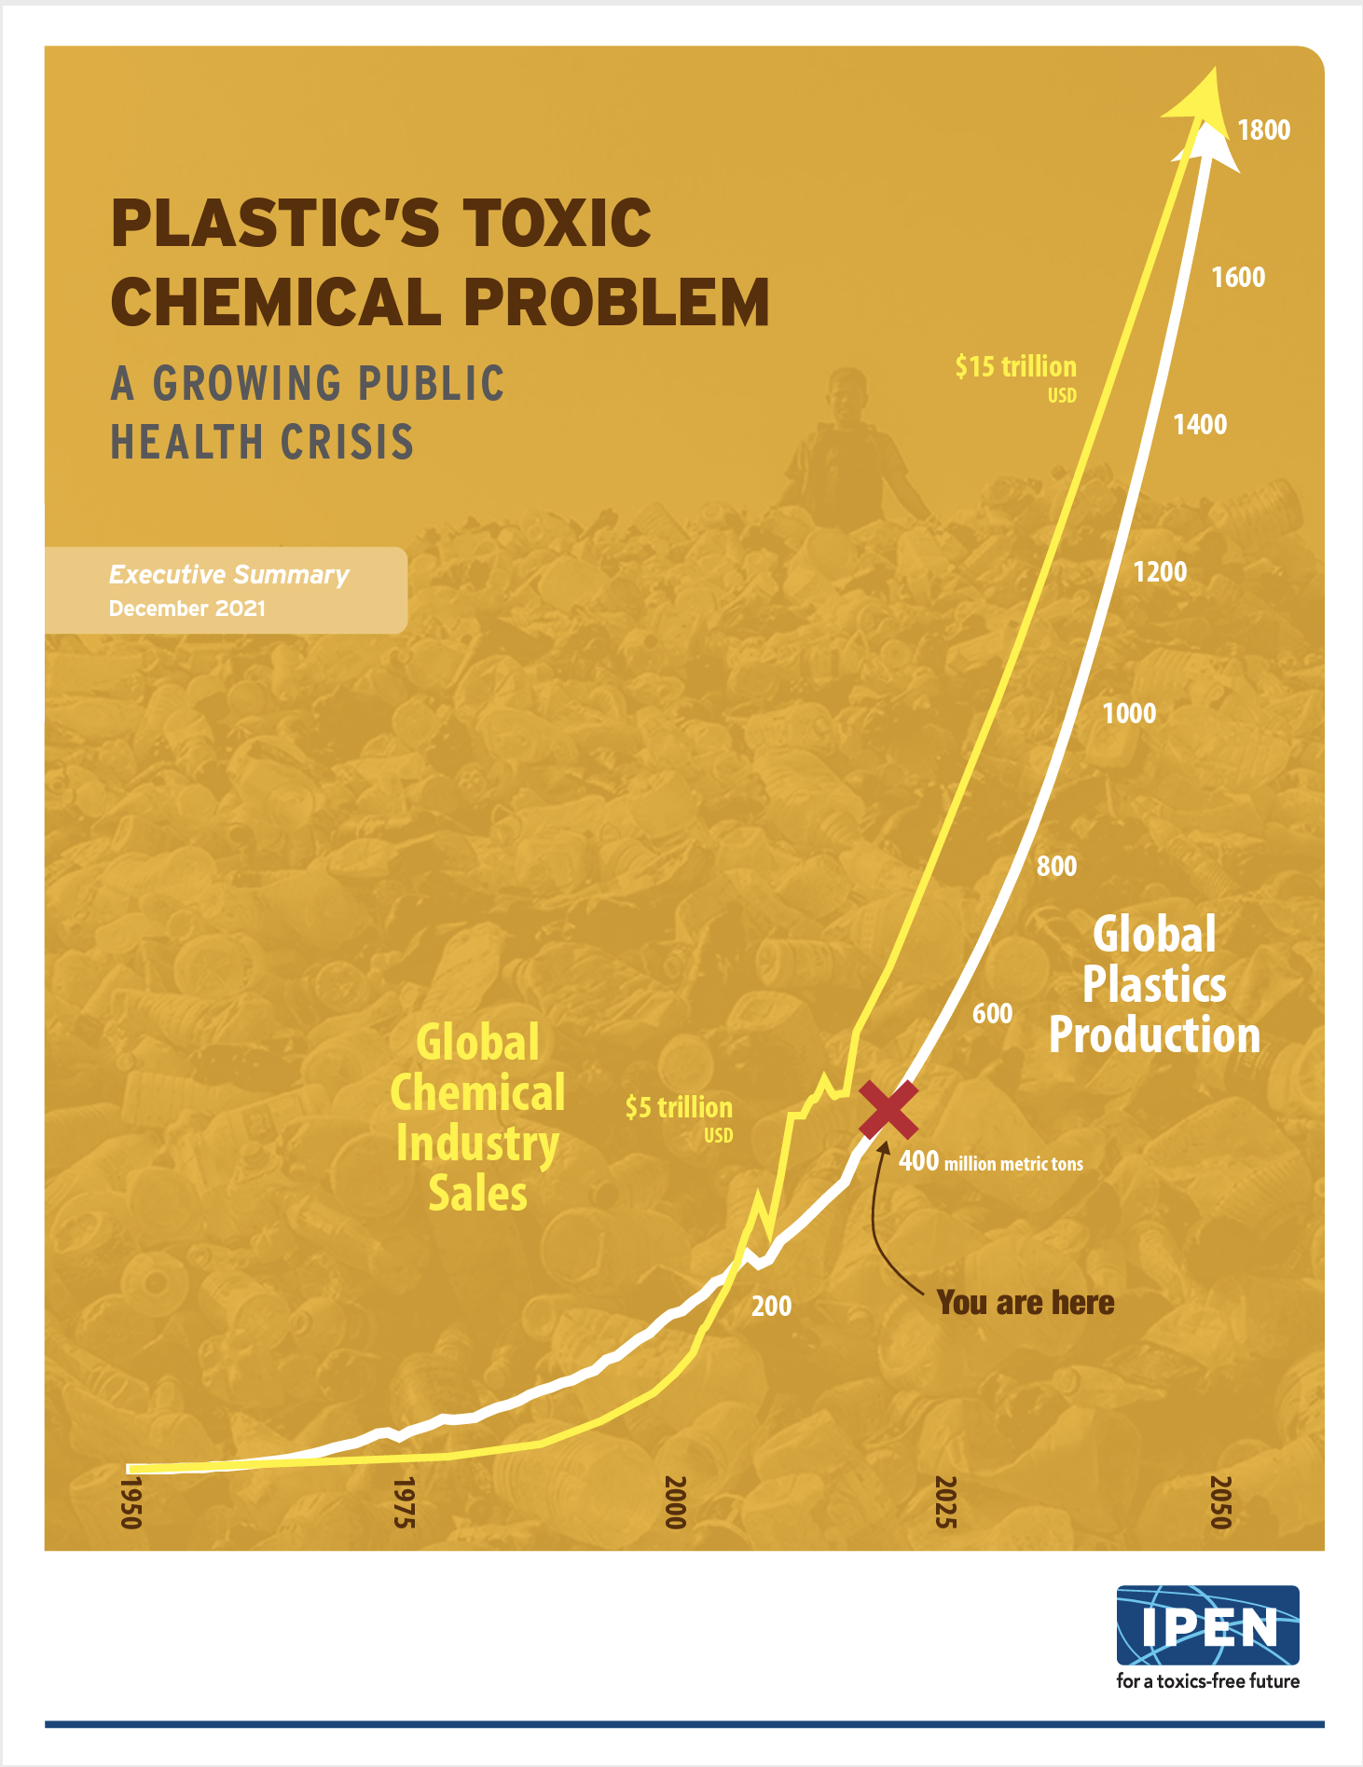
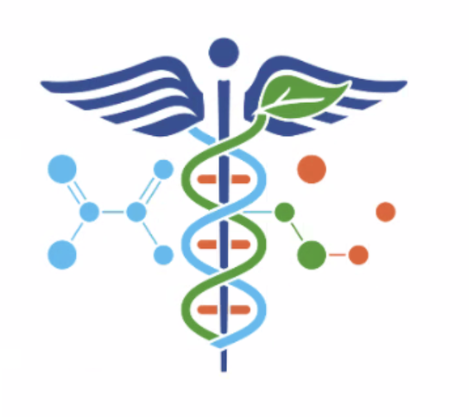
Plastics comprise 70% of the synthetic chemical industry.
We manufacture ten times more plastic than pesticides annually, but…
The majority of chemicals remain untested.
Ingredients are unknown
There is chronic universal human exposure.
But plastics have received virtually no attention from EPA.
Notes:
This is not just a litter problem. From the standpoint of living organisms, adding this many hazardous chemicals to the environment is likely to be unsurvivable.

Slide 9
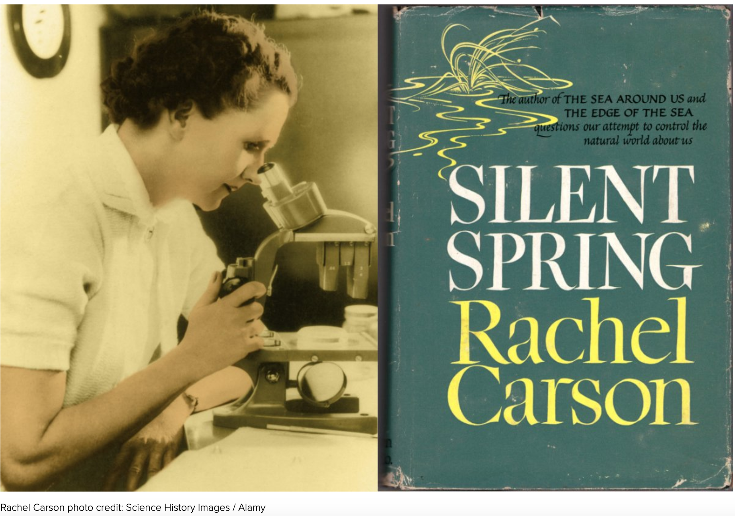
“Given time – time not in years, but in millenia – life adjusts, and a balance has been reached. For time is an essential ingredient; but in the modern world, there is no time.”
Rachel Carson
Notes:
Almost as soon as it started, the pace of production worried onlookers like Rachel Caron. Carson was concerned about the capacity of both humans and the ecosystem to adapt to these new materials as quickly as they were coming out.
She wrote: “Given time – time not in years, but in millenia – life adjusts, and a balance has been reached. For time is an essential ingredient; but in the modern world, there is no time.” (7)
Carson raised a new public awareness that nature was vulnerable to human intervention.
She surfaced the idea that technological progress can sometimes be so fundamentally at odds with natural processes that it must be curtailed.

Slide 10
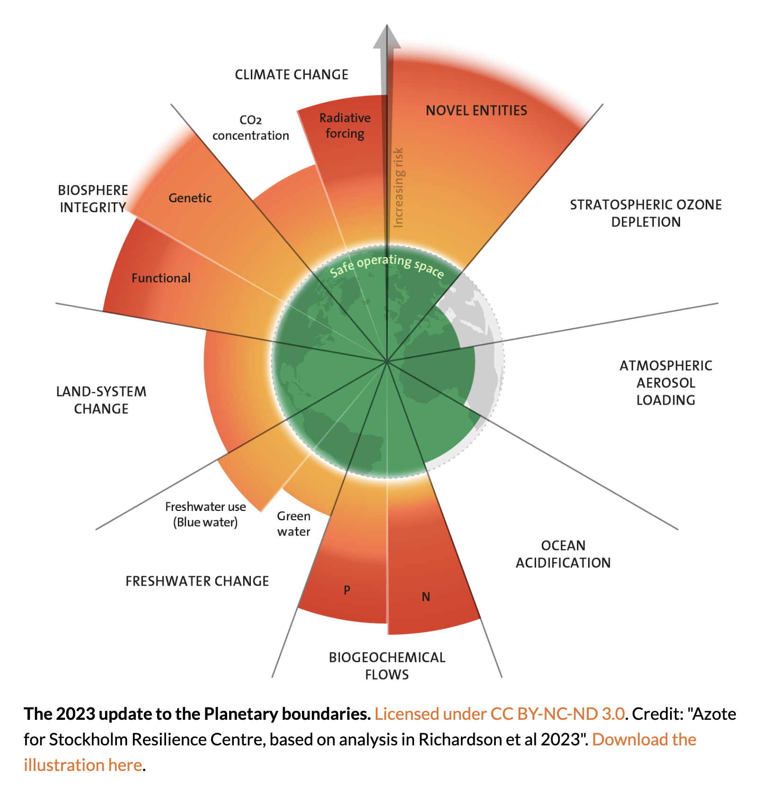
350,000 novel chemicals have been registered for global production (wang et al 2020)
50,000 are “confidential”
70,000 are ambiguously described
How many have been studied?
  About 3500
But we only understand the large scale environmental impacts of 65

Slide 11
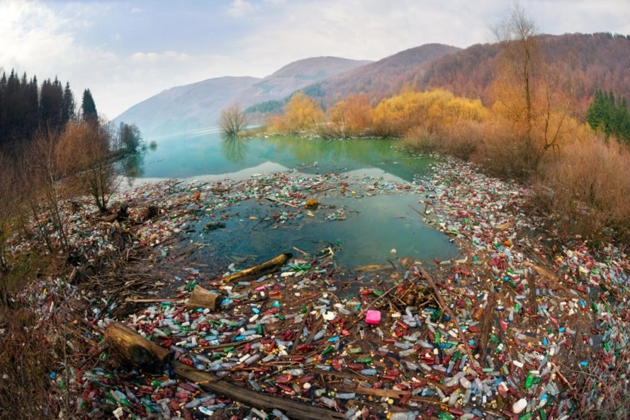
Roman Mikhailiuk / shutterstock
Notes:
One way or another, plastics and their additives wind up in the ecosystem.

Slide 12
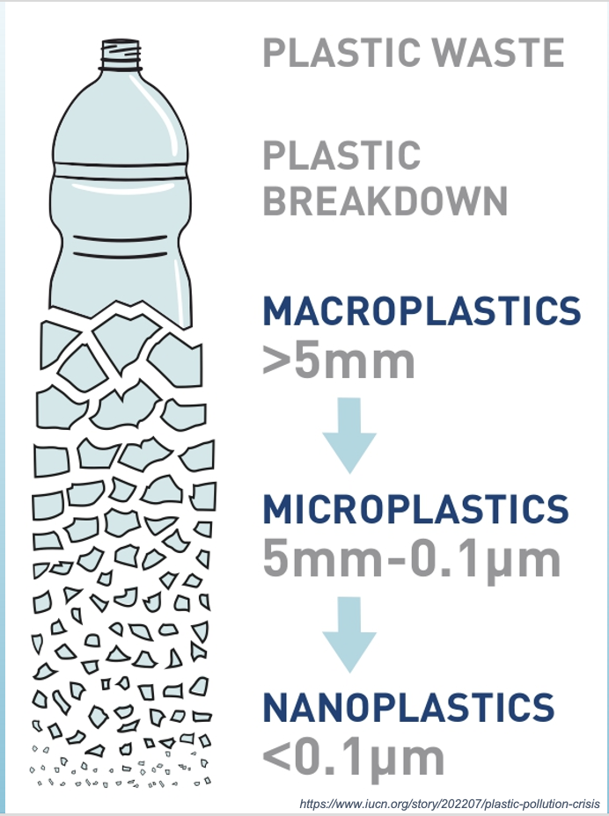
Notes:
In its absolute and final disposition, we suspect that the destination of most of the plastic in existence on earth is microplastics.
Plastic doesn’t break down in the environment. Instead, it breaks up into tinier and tinier pieces. A “microplastic” is anything smaller than a pencil eraser, but as it goes down it can become nanoplastic, which is smaller than a blood cell. And it goes smaller still. At this point, we have no evidence that plastic ever returns to its base elements – which is something that scientists like to talk about over drinks at big meetings.
It is worth thinking of plastic sort of like skin – wherever it is, it is constantly shedding micro and nano plastics.
The plastic that hasn’t yet broken into fragments is what is referred to as a “toxicity debt.”

Slide 13
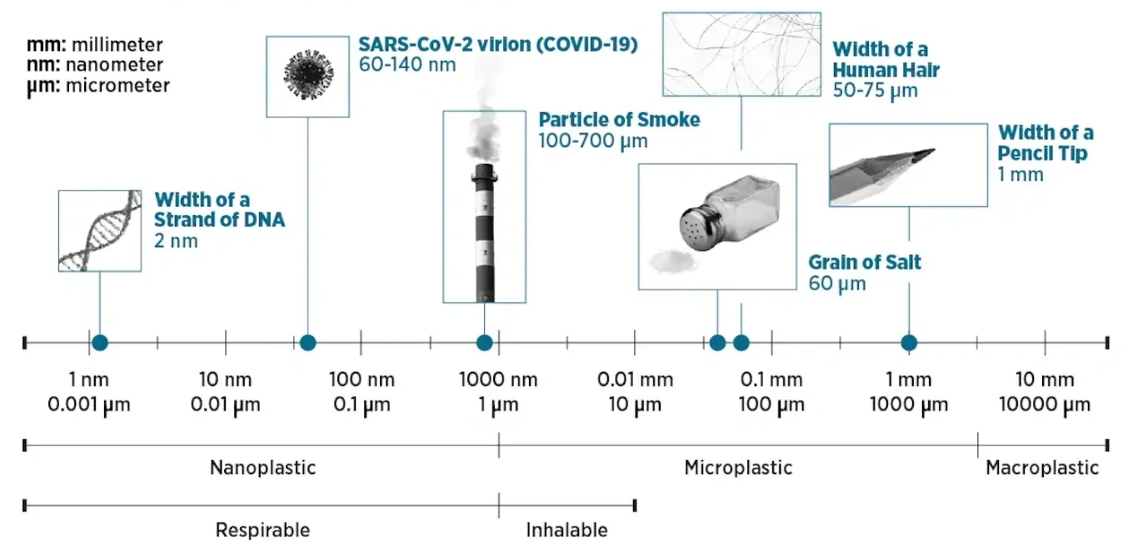
Microplastics and nanoplastics are very small…
Source: https://saveourbays.org.uk/plastics
Slide by Elizabeth Ryznar, MD
Notes:
So how small are these pieces? As a frame of reference, microplastics are the side of a pencil tip or grain of salt, whereas nanoplastics [click] are the size of a particle of smoke, a virus, or a DNA strand.

Slide 14
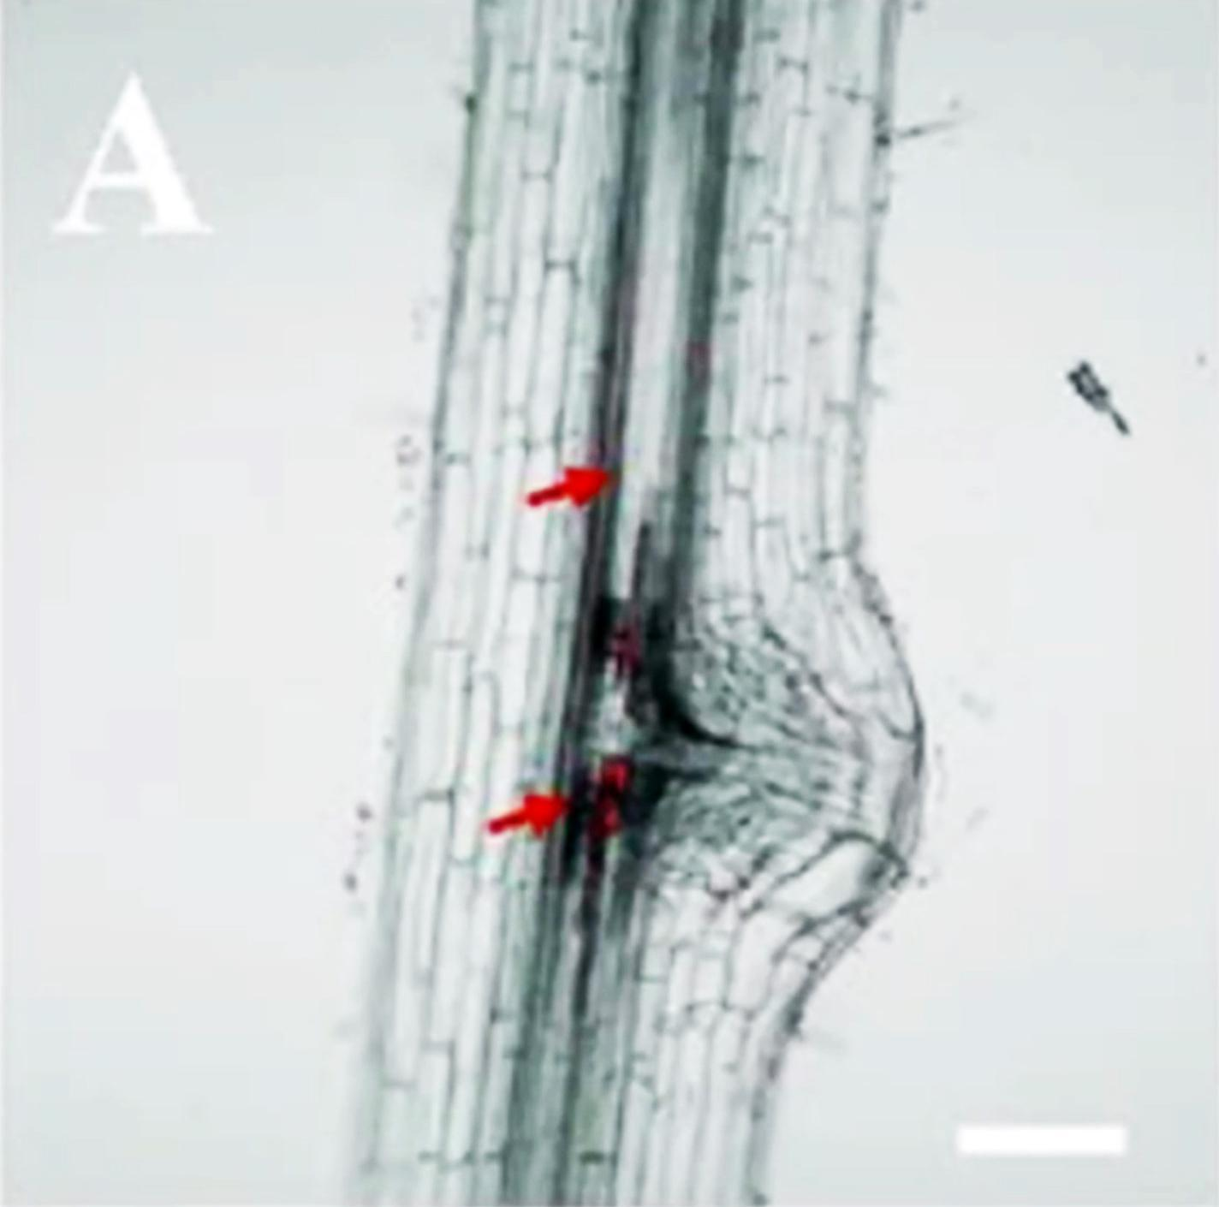
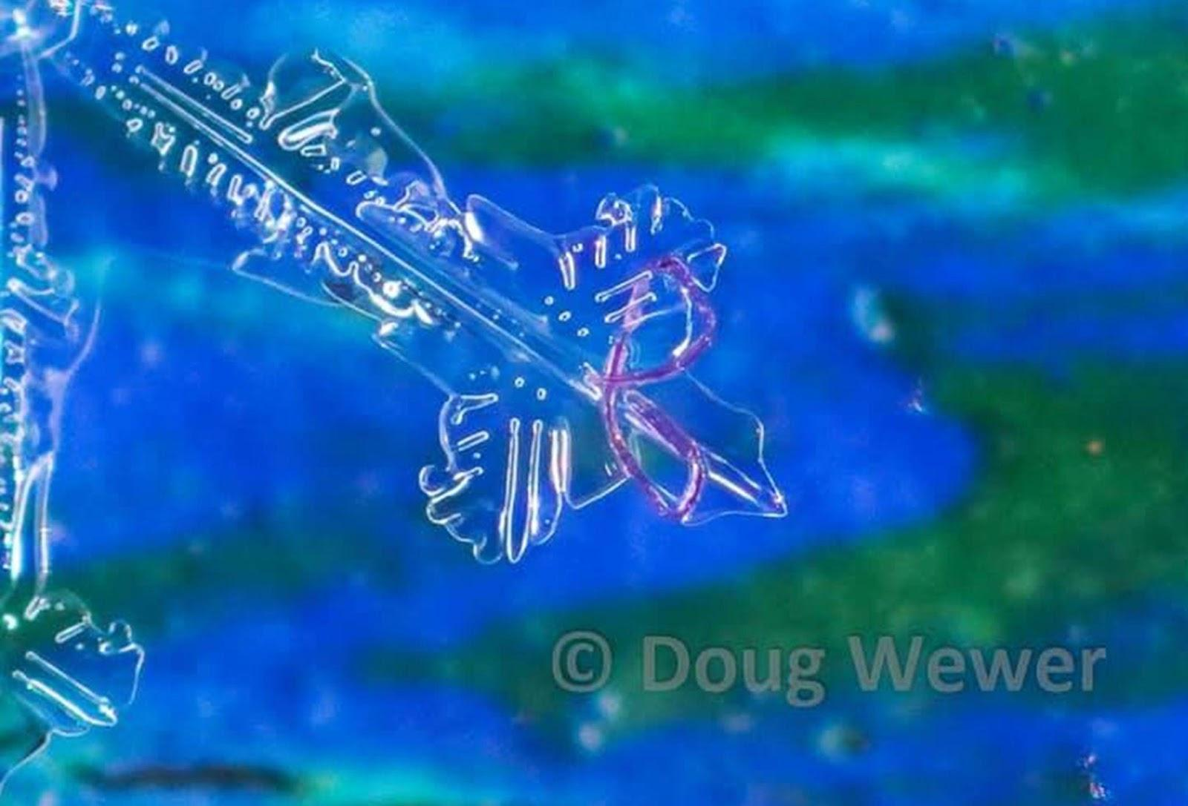
Microplastic filament on a snowflake
Uptake in Plants
Li, L., Luo, Y., Peijnenburg, W. J., Li, R., Yang, J., & Zhou, Q. (2020). “Confocal measurement of microplastics uptake by plants.” MethodsX, 7, 100750
Notes:
In this slide you can see a microfilament caught on the edge of a snowflake.
Microfilaments, by the way, are what come off of our synthetic clothing. They are shed by fleeces and sportswear and any textile made from a synthetic base.
This second image haunts me. It shows a nanoplastic that has been drawn into the vasculature of a plant. Not surprisingly plants choked with microplastics have lower crop yields. Which is scary.
Some of that reduction is due to what is happening to the soil as much as the plant. Microplastics interact with organisms in soil, such as soil dwelling invertebrates, terrestrial fungi, and plant‐pollinators.
They may arrive on fields by way of sewer sludge, which is spread as a fertilizer, but they are often also directly applied to croplands in the form of pesticides, fertilizers, and even seeds that are directly encapsulated in plastic.
These microplastics can change the physical structure of earth and limit its capacity to hold water. That can affect plants by reducing root growth and nutrient uptake.
These plastics remain longer than any other element in the agricultural soil. Microplastics from sewer sludge have been detected up to 15 years after application. Microplastics applied directly with seeds, fertilizers, and pesticides are cumulative, and build up year after year without cease.
According to the Center for International Environmental Law (CIEL), agricultural soils now store between 4 and 28% more microplastics than oceanic basins.
recent estimates of plastic-carbon in soil suggest that plastics may exceed total microbial carbon by 2095. (Dunlop ¹⁴⁵⁾

Slide 15
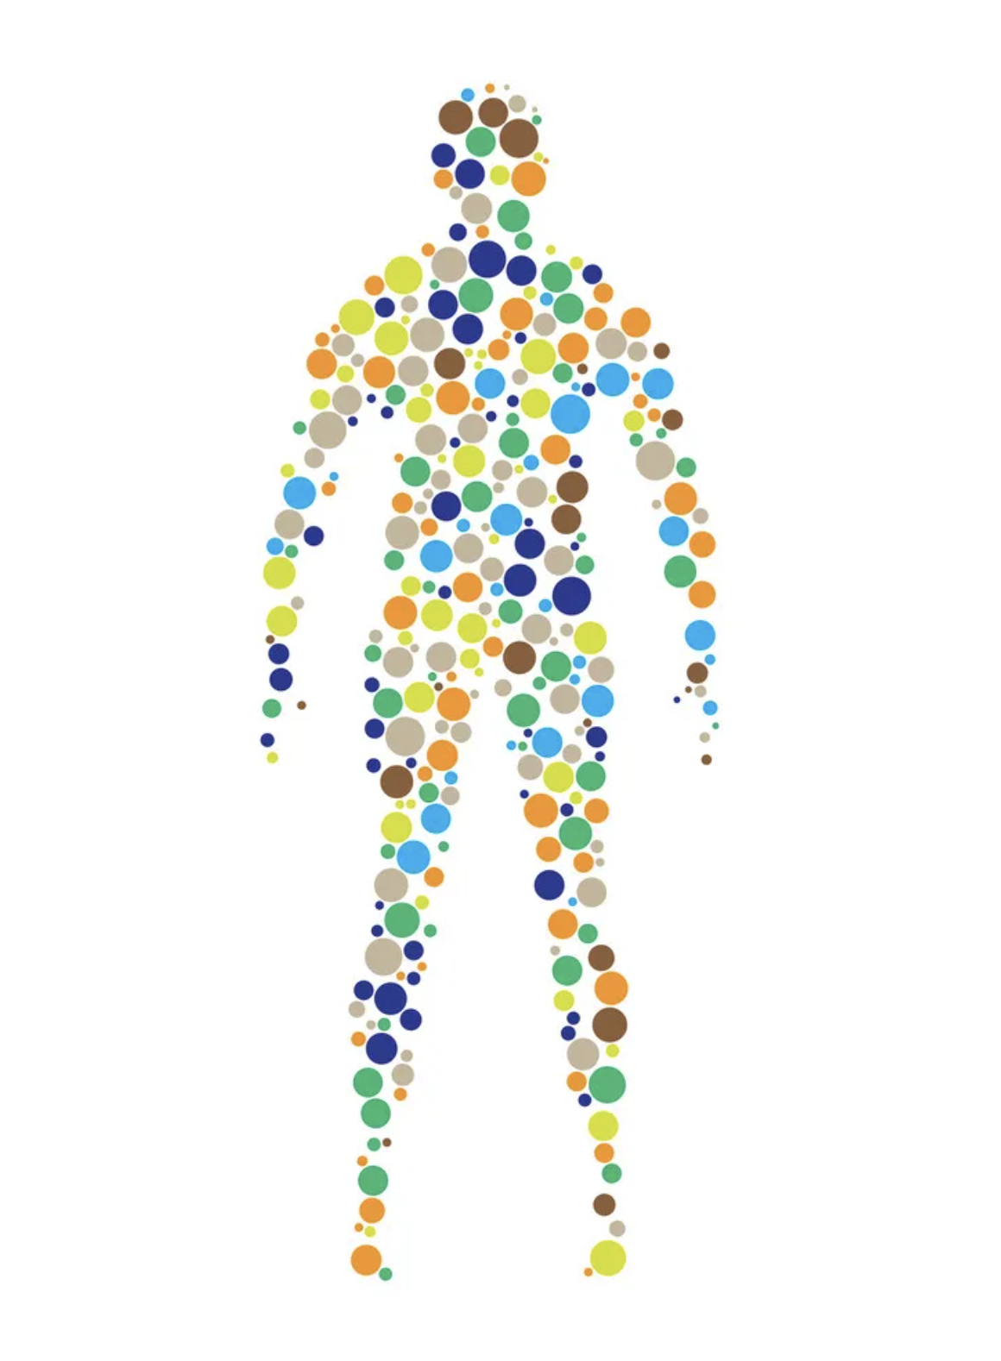
What does it mean
for us?

Slide 16
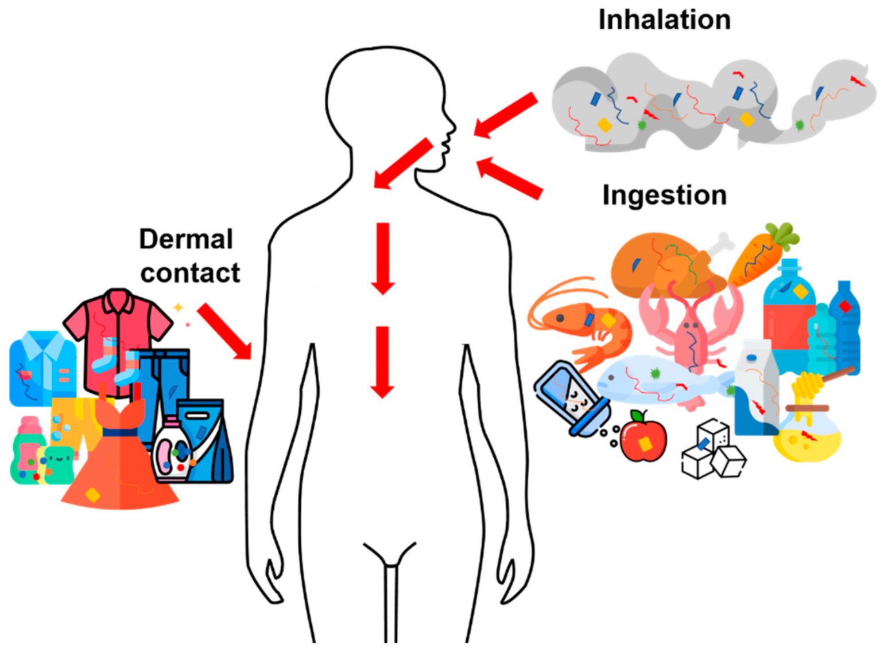
Source: Pironti, C., Ricciardi, M., Motta, O., Miele, Y., Proto, A., & Montano, L. (2021). Toxics, 9(9), 224.
Notes:
Microplastics primarily enter our bodies by ingestion of food and liquid containing microplastics particles.
But we also inhale microplastics found in household dust and polluted air.
Most MNPs likely exit our bodies in our stool, but the smallest particles, or nanoplastics in the range of 1 to 100 microns, are absorbed through the gut or lungs.
Absorption through skin is less well studied, but can occur from topical personal care products and contact with plastic.

Slide 17
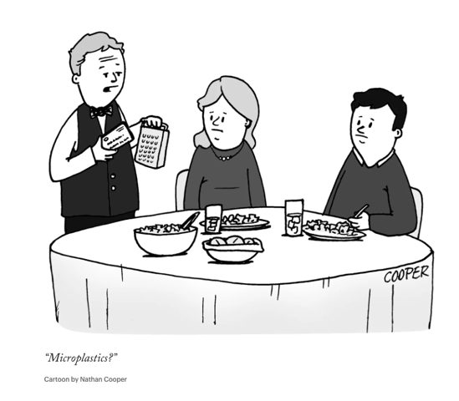
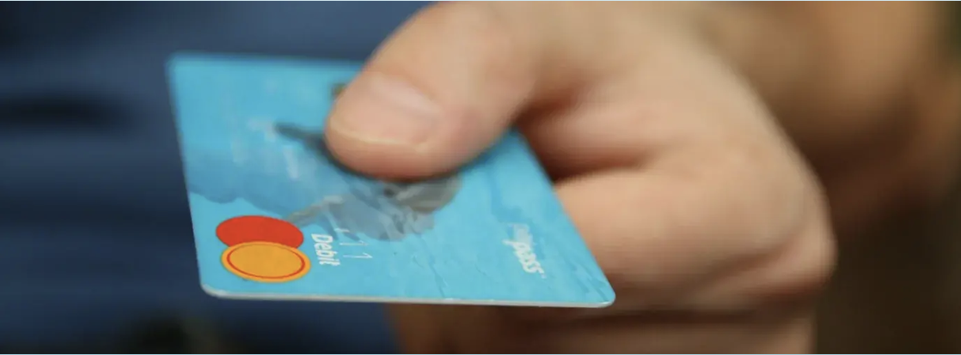
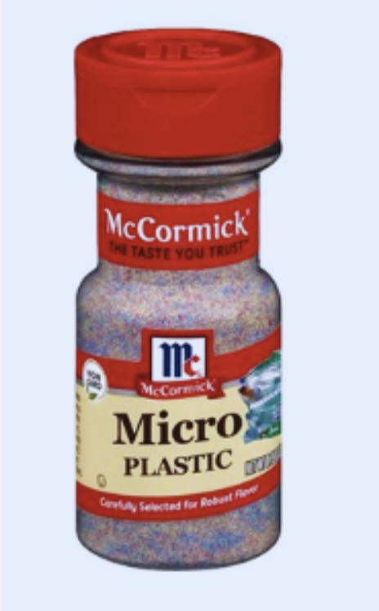
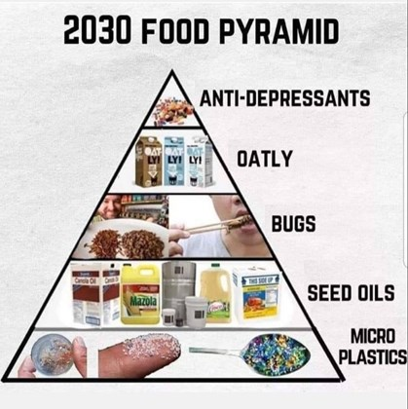
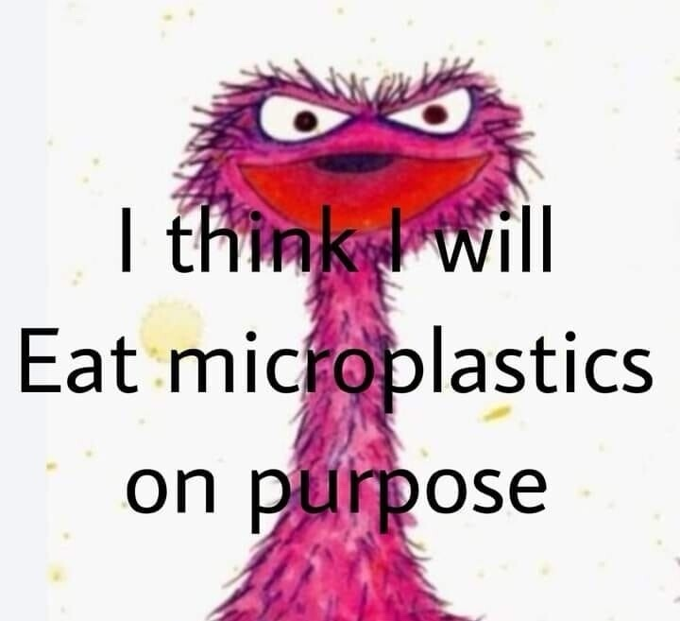
Yum!
“I eat a credit card every Sunday. Just get it all out of the way and have a nice plastic-free week.”
Notes:
Let’s take it from the top. For the last handful of years, newspaper headlines have been dominated by announcements that we are all eating, drinking, and breathing enormous amounts of microplastic.
In 2019, an article out of the University of Newcastle in Australia estimated that some of us maybe eating as much as 5g of plastic per week, which is the weight of an entire credit card. That figure went viral, and has been both heavily memed and frequently challenged, but the fact remains that our intake of plastic is remarkably high.
What happens to all that plastic?

Slide 18
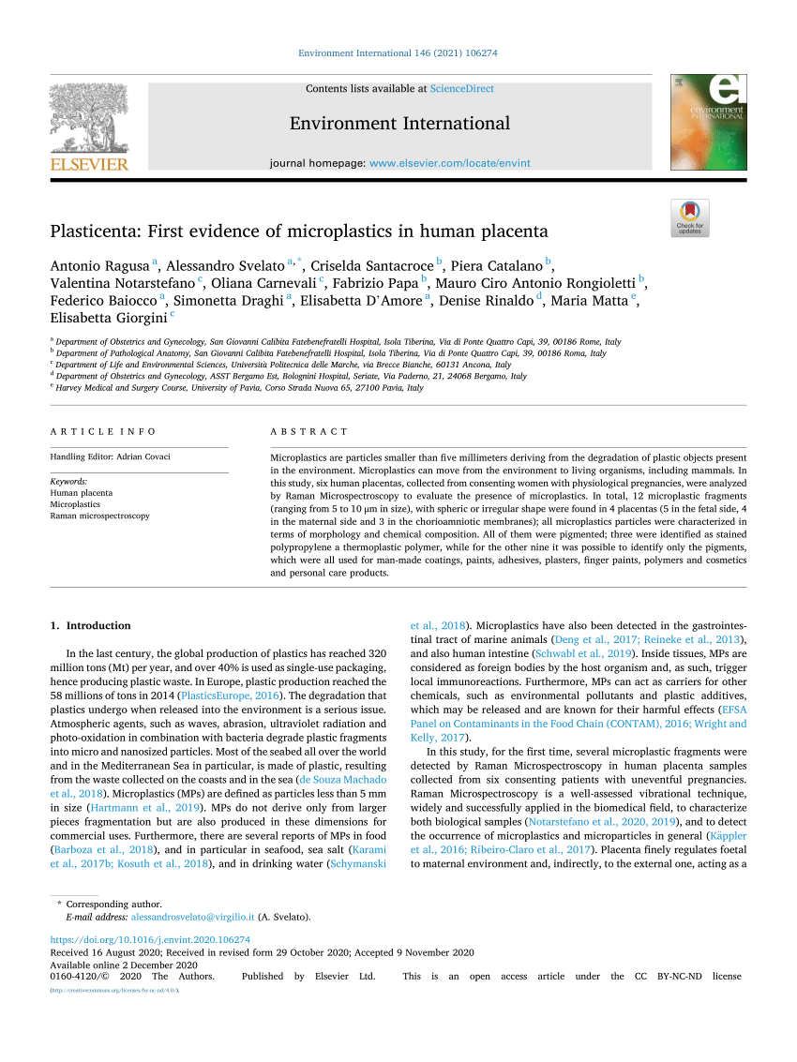
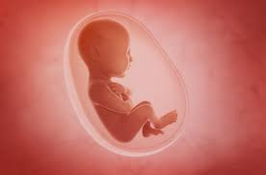
Where are the microplastics?
January, 2021
Notes:
Ragusa: “Unfortunately, we do not know how MPs reach the bloodstream and if they come from the respiratory system or the gastrointestinal system.” “ The most probable transport route for MPs is a mechanism of particle uptake and translocation”
nanoparticles of plastic inhaled by pregnant laboratory rats were detected in the liver, lungs, heart, kidney, and brain of their foetuses. (Fournier, S. B., D’Errico, J. N., Adler, D. S., Kollontzi, S., Goedken, M. J., Fabris, L., ... & Stapleton, P. A. (2020). Nanopolystyrene translocation and fetal deposition after acute lung exposure during late-stage pregnancy. Particle and Fibre Toxicology, 17, 1-11.)
In 2021, a team of Italian scientists demonstrated that microplastics are crossing into the placenta and are present in the fetus at birth. An infant’s first stool, called meconium, can contain microplastics.

Slide 19
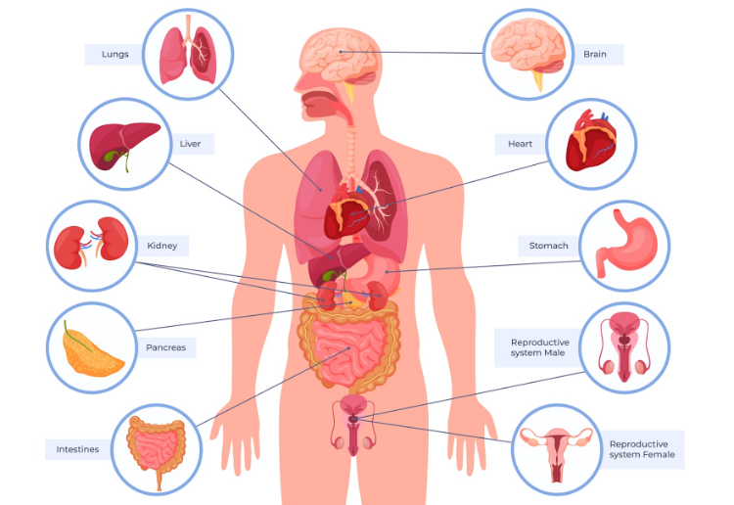
Where are the microplastics?
Human Feces - Oct 2018
Placenta - Jan 2021
Lung - May 2021
Meconium - June 2021
Sputum - Jan 2022
Blood - May 2022
Breast Milk - June 2022
Liver - Aug 2022
Urine - Dec 2022
Veins - Feb 2023
Testes/Semen - March 2023
Heart Tissue - Aug 2023
Kidney - Feb 2024
Carotid plaque - March 2024
Brain - May 2024
Olfactory Bulb - Sept 2024
Bone - Nov 2024
Follicular Fluid - Feb 2025
Notes:
In the meantime, let’s look at where the “unseen threats” have been noted, at least in the human body.
A quick review from last Weds.

Slide 20
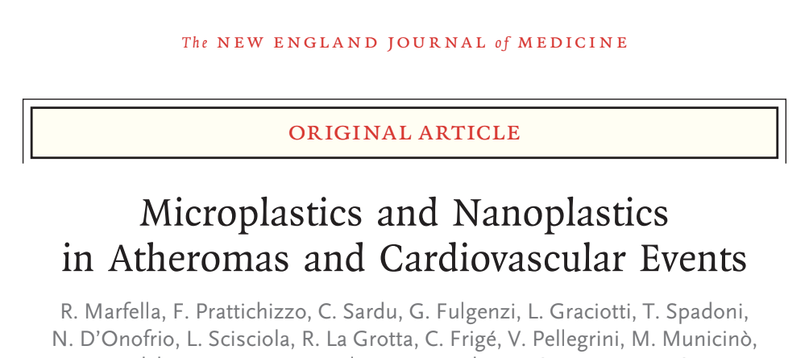
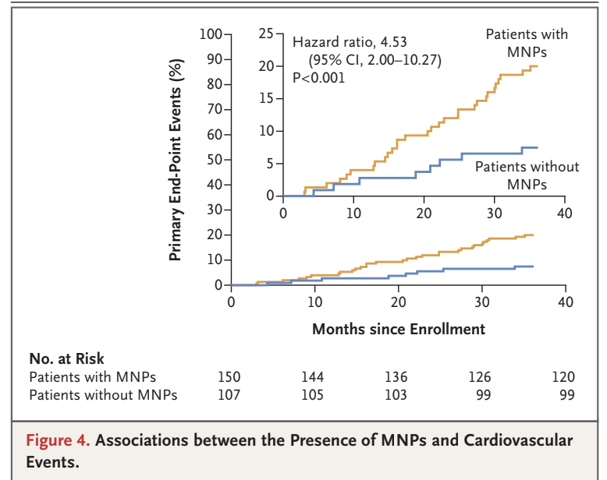
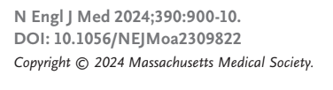
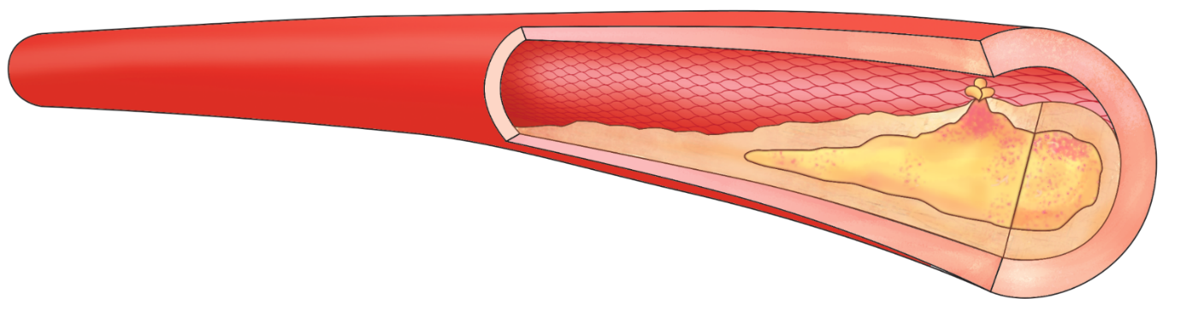
Notes:
New England Journal of Medicine – March 7, 2024
312 patients who underwent carotid endarterectomy
Microplastics and nanoplastics (MNPs) were detectable
in the excised plaque of 58% of the patients
Patients with MNPs had a 4.5-fold (450%) increase in risk for nonfatal myocardial infarction, nonfatal stroke, or death over the next 3 years.
Only one study. Does not prove causation. But a striking finding and very worrisome

Slide 21
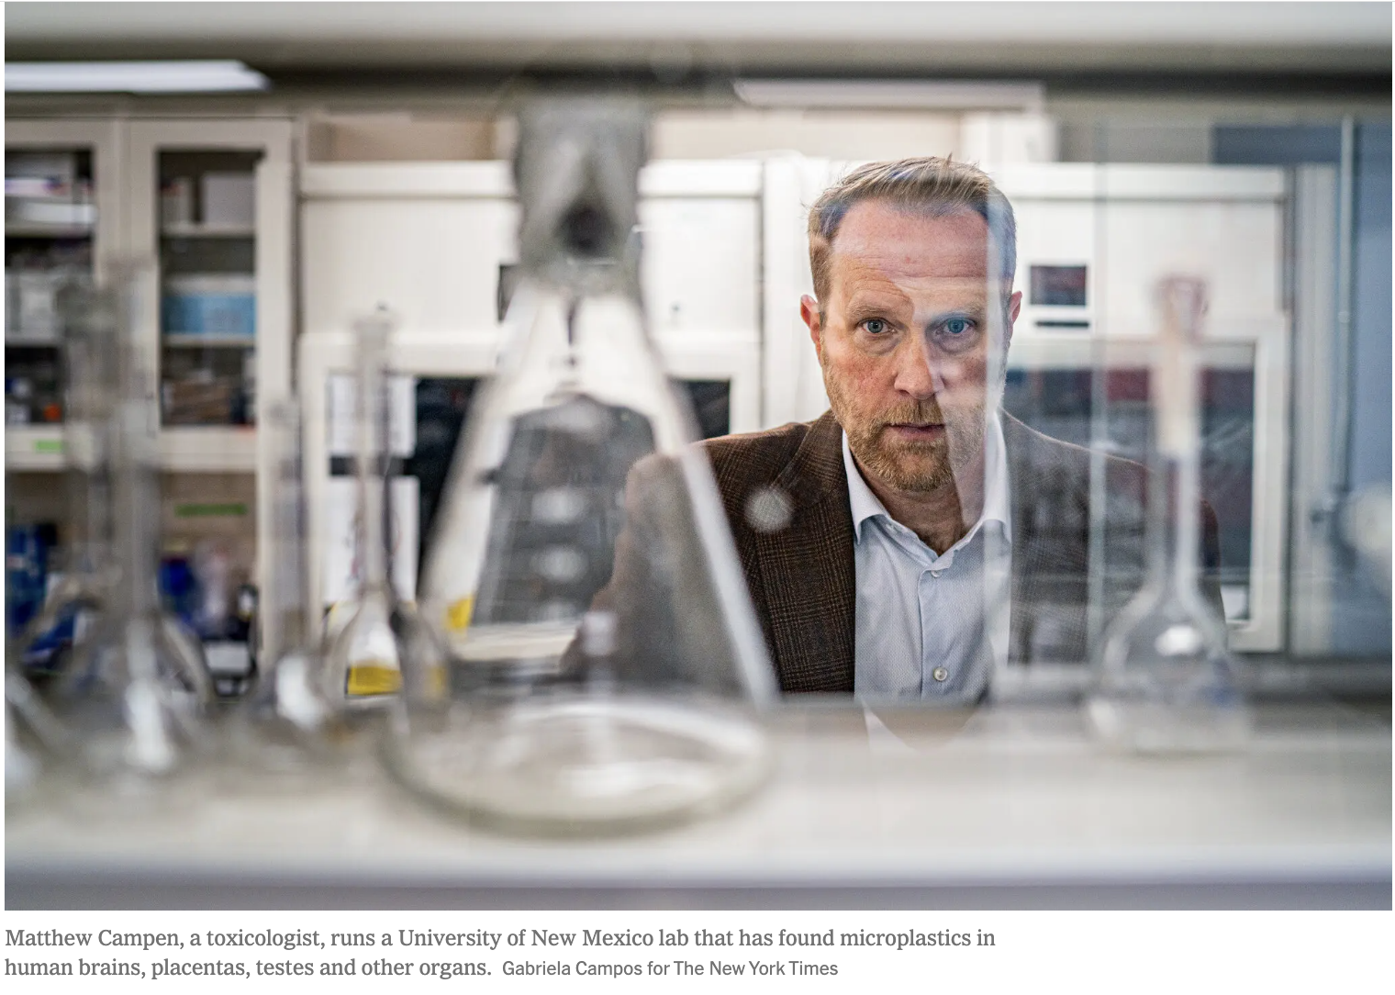
The Campen Lab

Slide 22
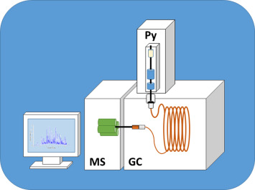
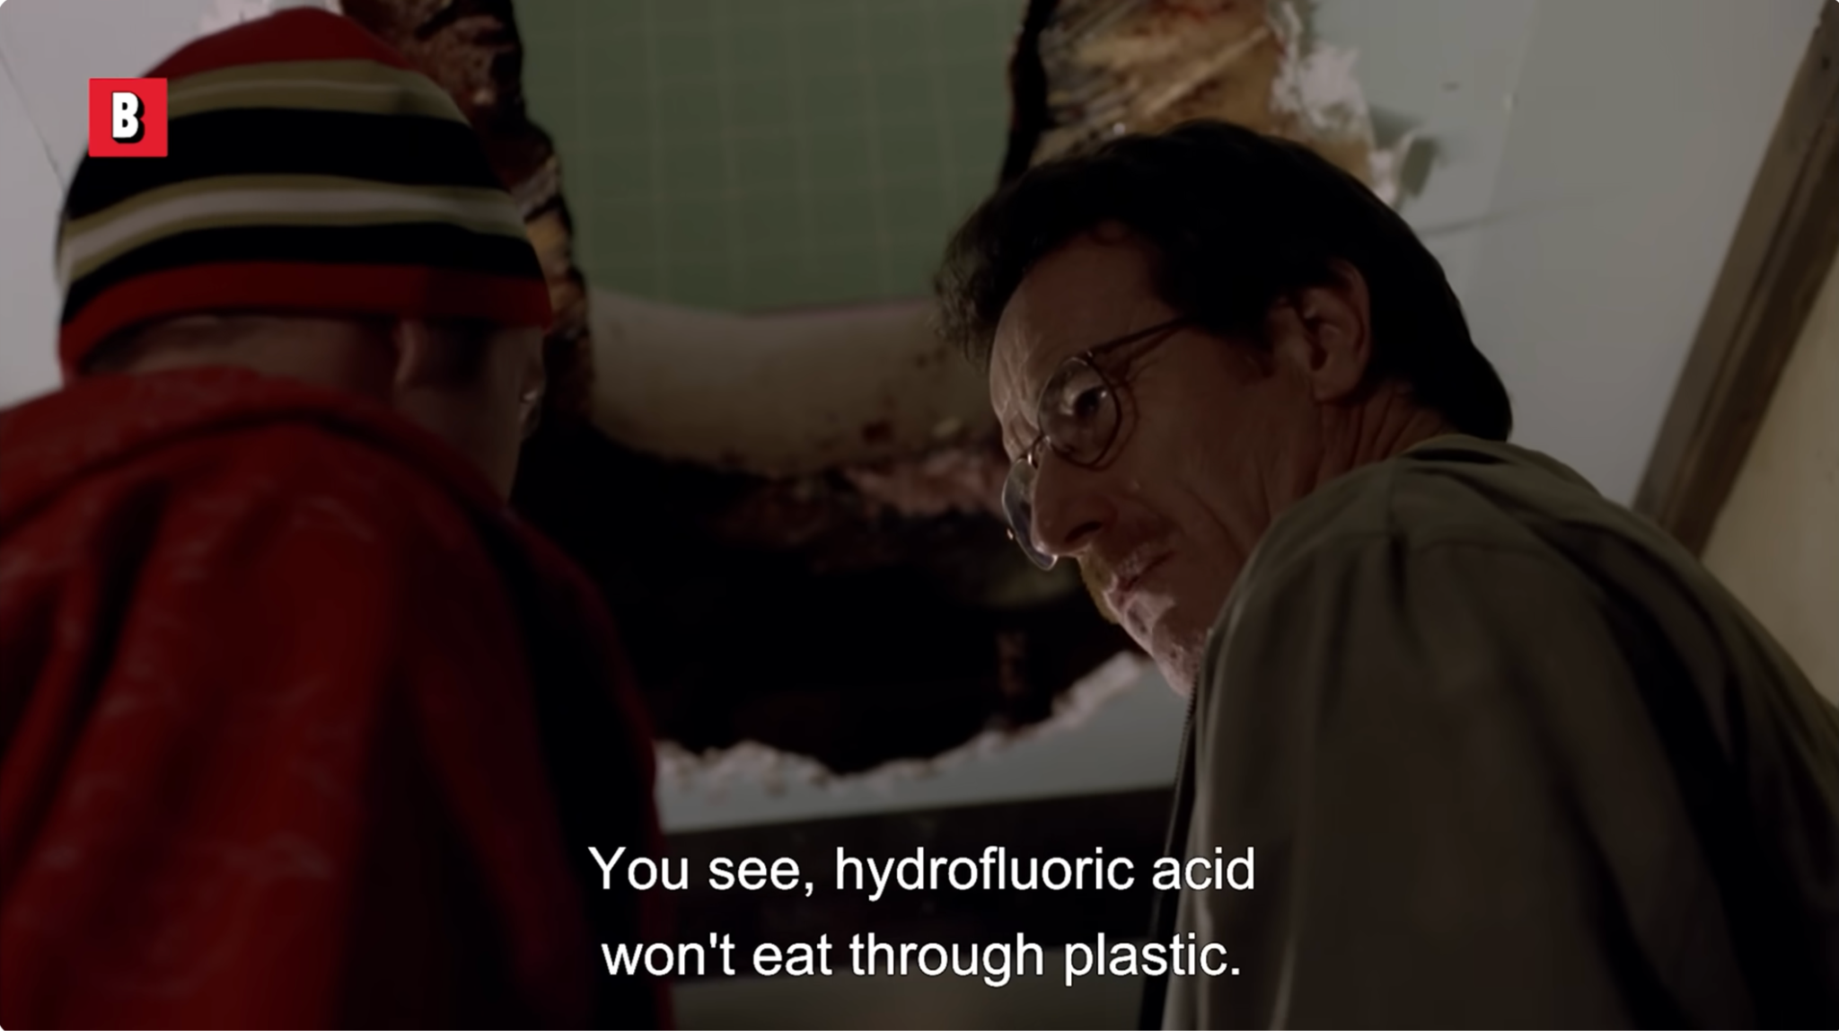
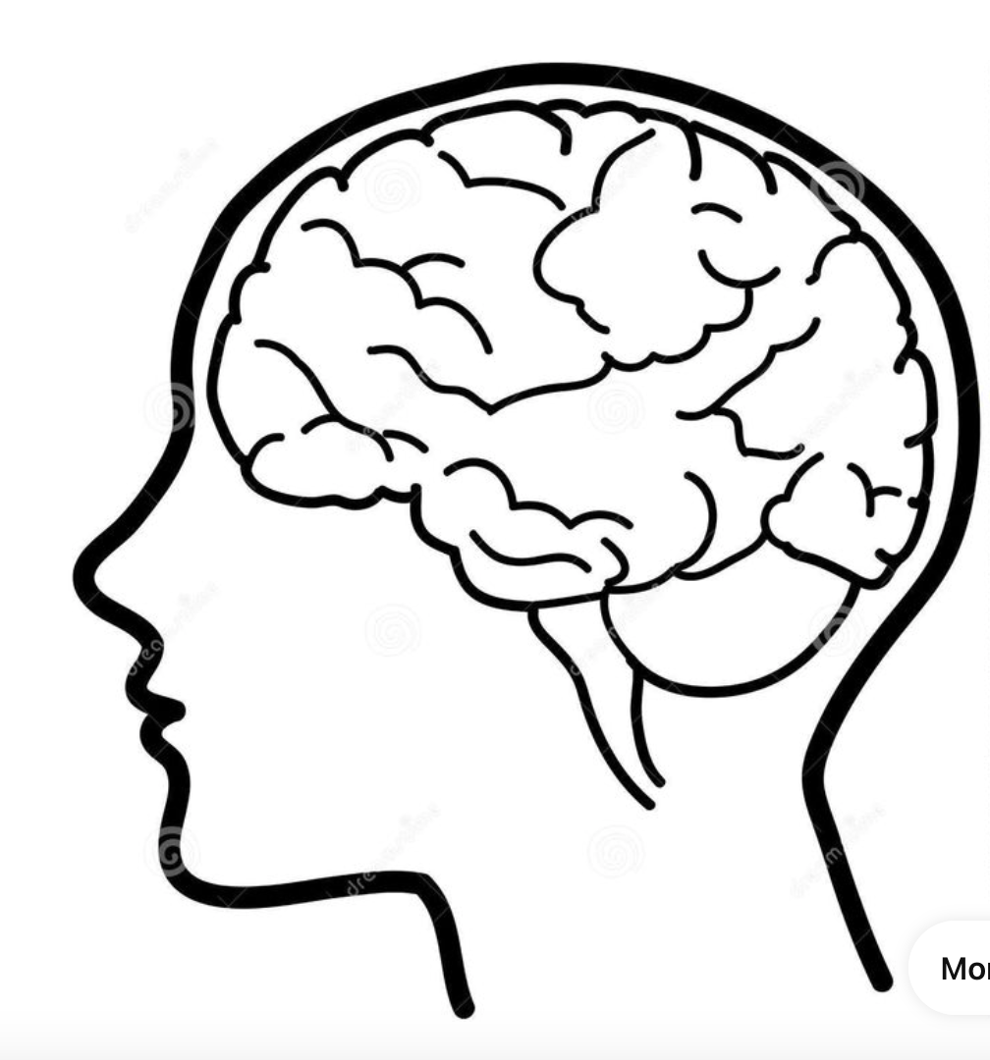
Pyr - GC/MS
It will, however, dissolve metal, rock, glass, ceramic. So there’s that.”
Shannon Osaka: Pyr GC/MS: In the pyrolysis method, researchers burn the tissue, and then examine the resulting vapors for various chemicals. They can match the signature of plastic chemicals to the vapors they find.
Notes:
This is a way to identify Molecules present in sample
heights of the peaks connote the relative abundance of the various components in the sample.
each component identified by its mass spectrum.
Macromolecules such as paint binders will decompose into smaller volatile fragments. Under controlled conditions (temperature, heating rate, and time), the same distribution of smaller molecules can be produced. The fragments are then separated by GC and identified or characterized using MS.

Slide 23
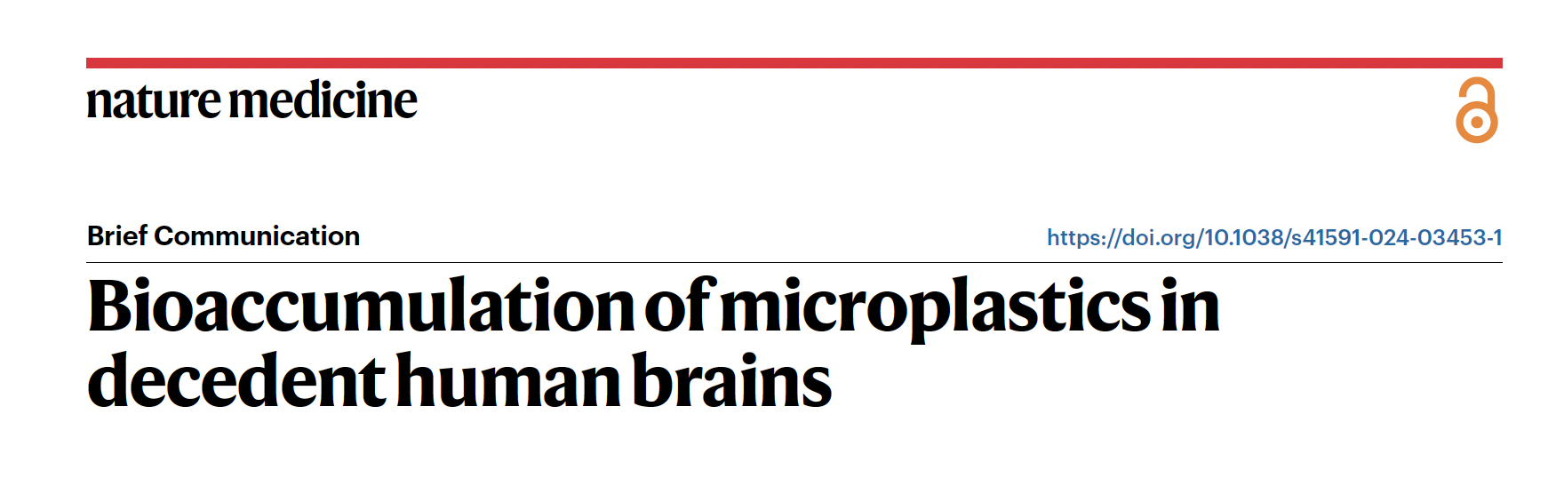
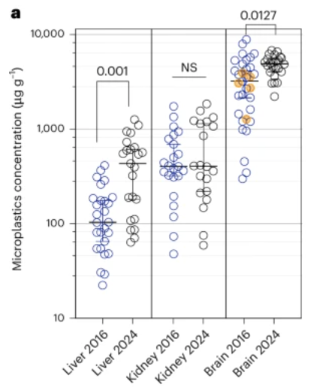
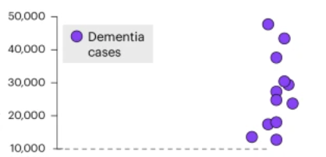
The brains of people with a history of alzheimer’s or dementia contained 5-10x more plastic
“MNPs are selectively accumulated into the human brain.”
“...total plastics mass concentration in brains increased over 50% in the past 8 years.”

Slide 24
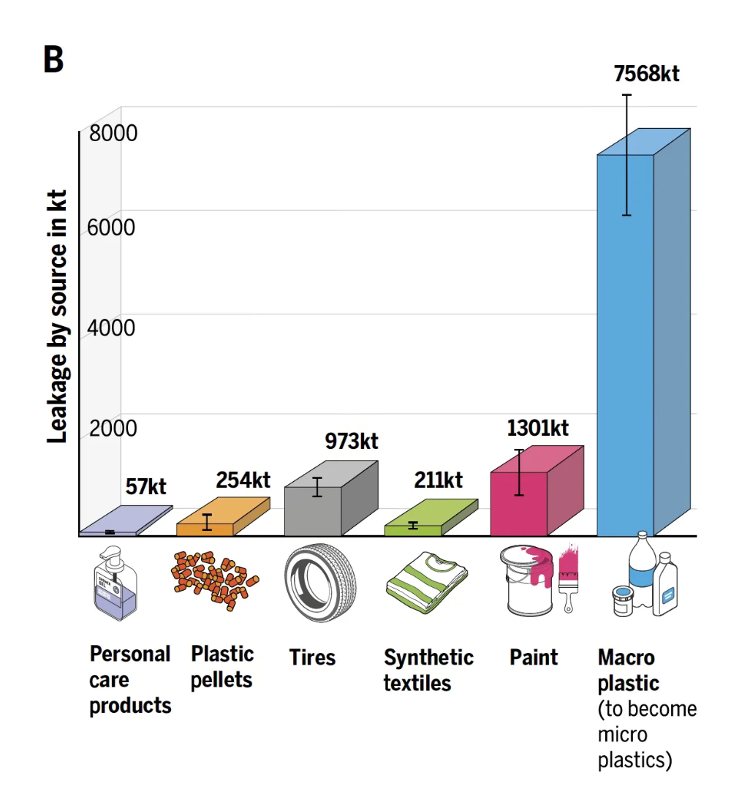
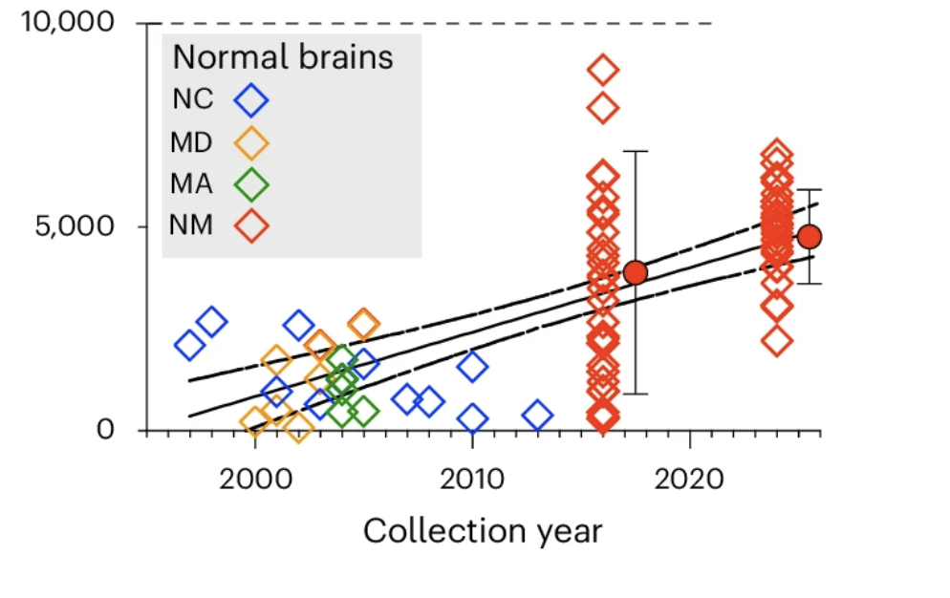
“...total plastics mass concentration in brains increased over 50% in the past 8 years.”
“Toxic Debt”
(Raubenheimer, Chemistry International, 2025)

Slide 25


Slide 26
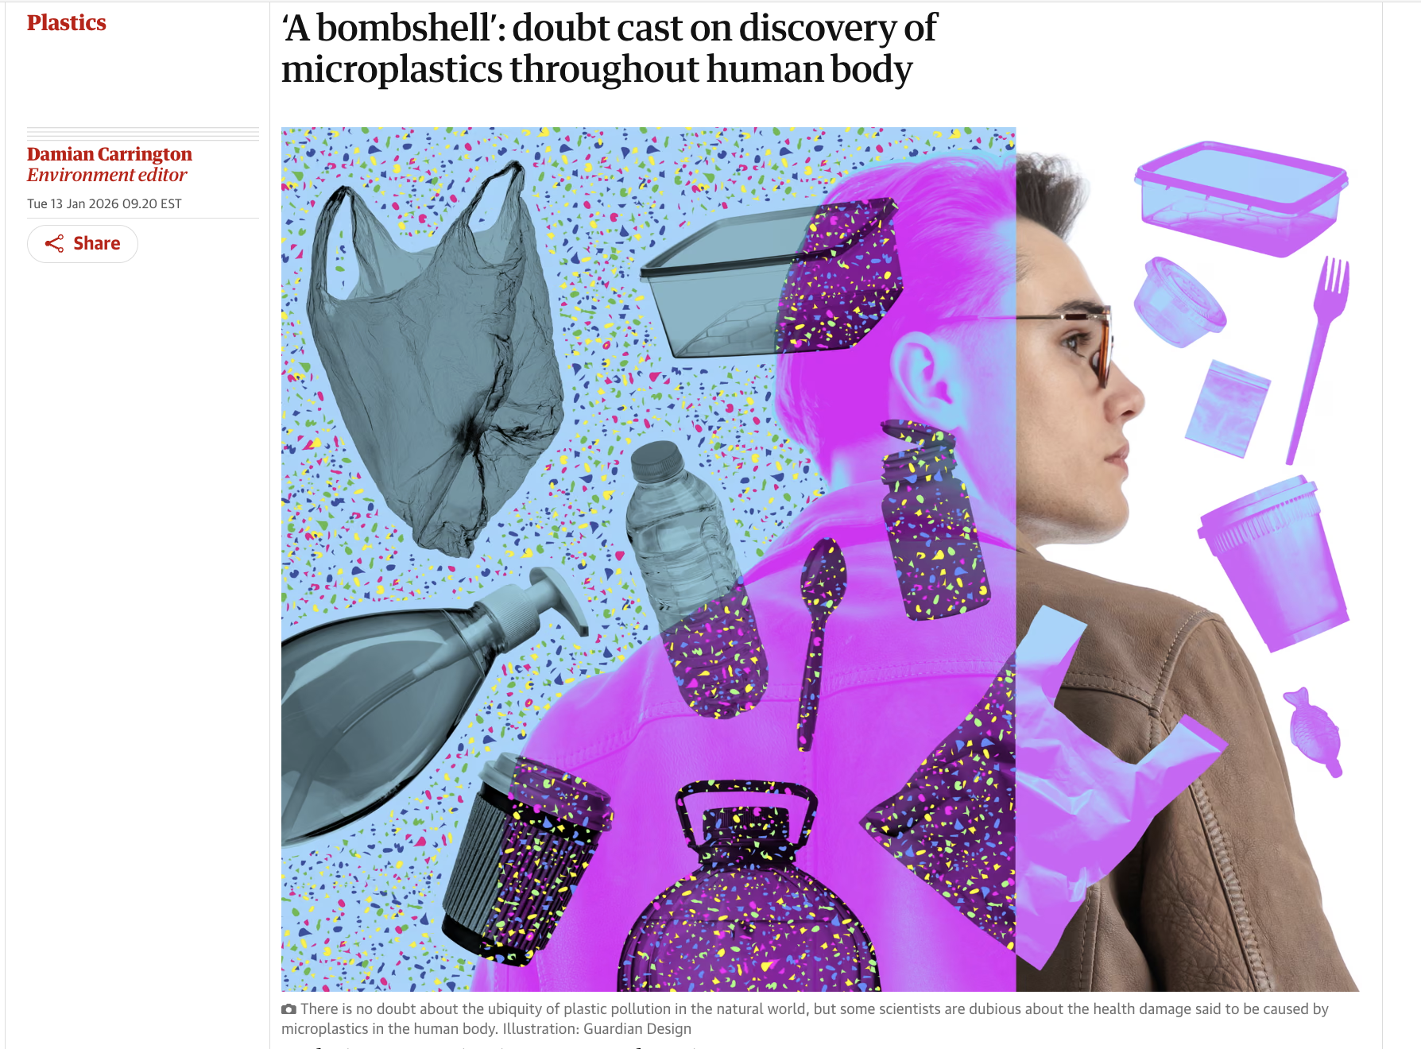
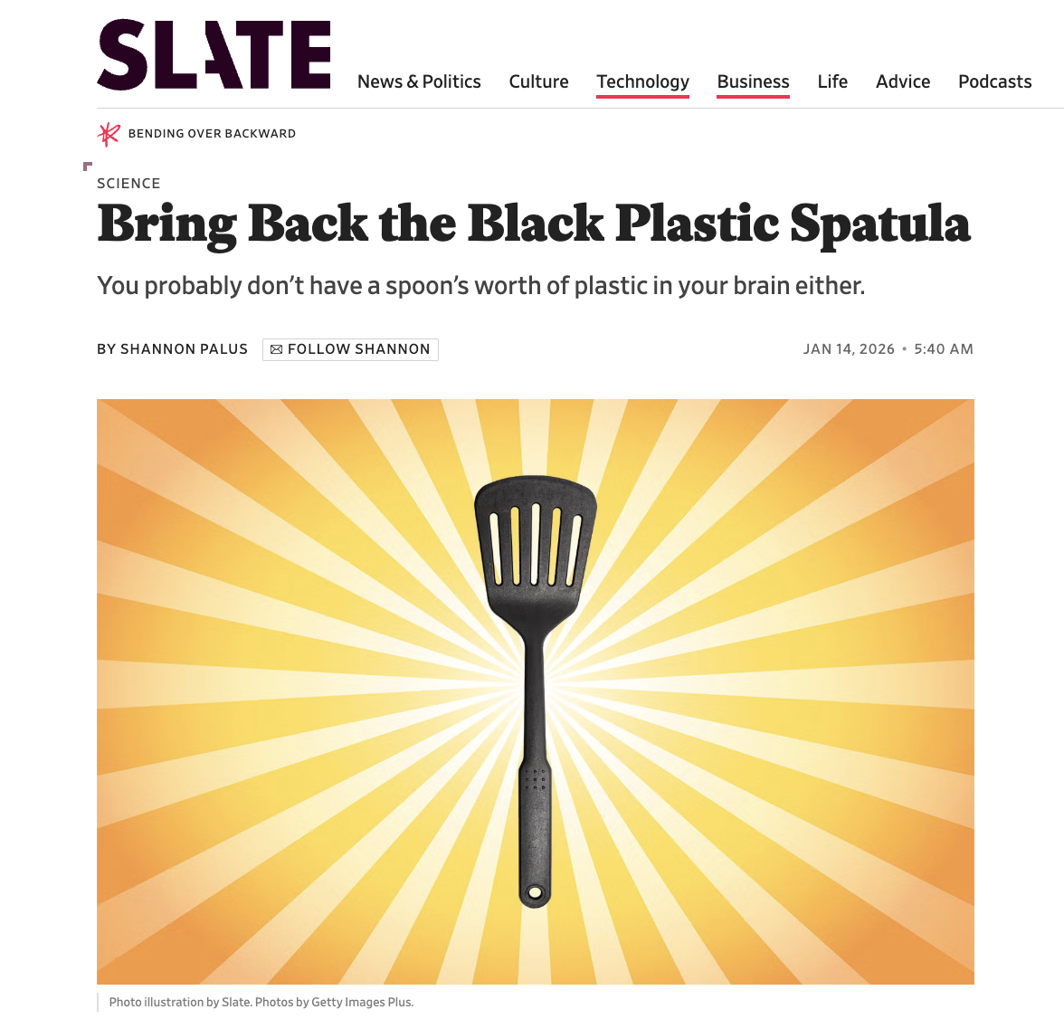
The Guardian
1/13/26
1/14/26

Slide 27
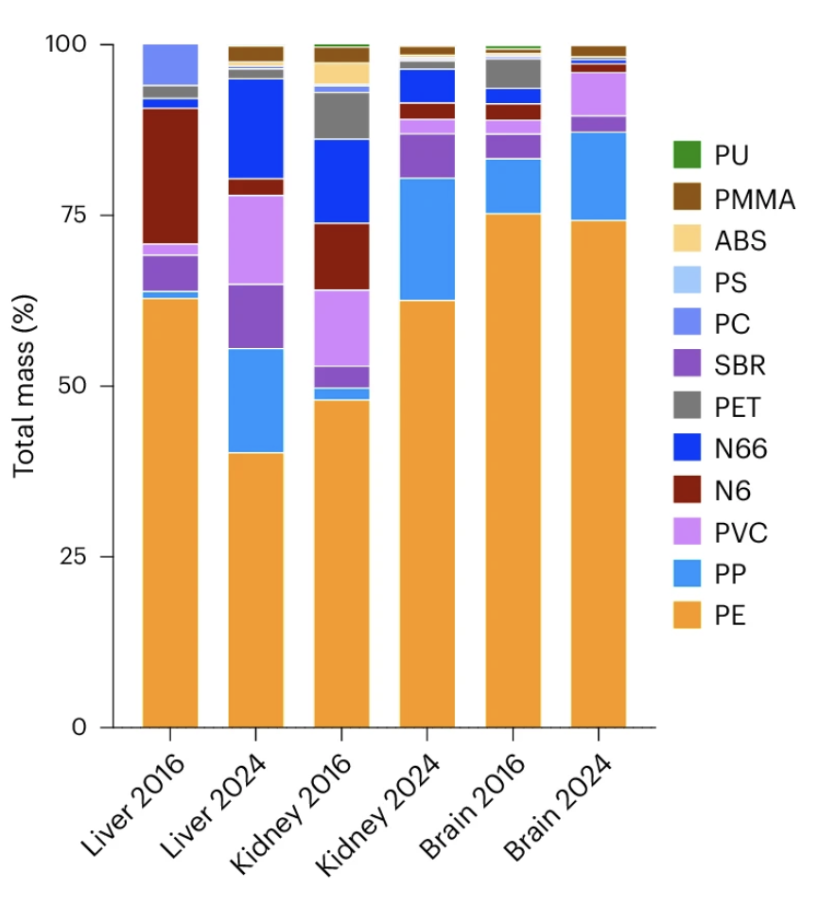
“Fat is known to make false-positives for polyethylene.”
Change is consistent over time.
#NotallPE

Slide 28
The Tobacco Playbook
Tactic | Example
Magnify or manufacture uncertainty | Emphasize limitations, variability, or unanswered questions while ignoring converging lines of evidence. Cherry-pick findings to suggest scientific uncertainty. Create industry-funded "experts" by promoting scientists or consultants with conflicts of interest as neutral voice.
Shift the burden of proof | Demand impossible standards of certainty before action, despite acting decisively in other domains with less evidence.
Promote false balance | Elevate fringe dissent to suggest scientific division where little exists.
Delay through research | Call for more studies as a substitute for policy, even when evidence already supports harm reduction.
“Roger Kuhlman, a chemist formerly at the Dow Chemical Company.”

Slide 29

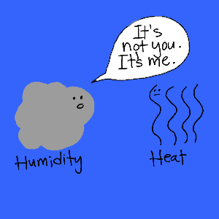

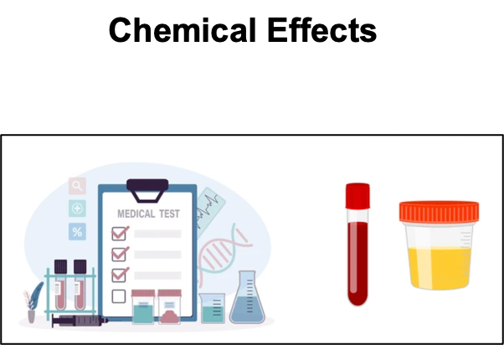
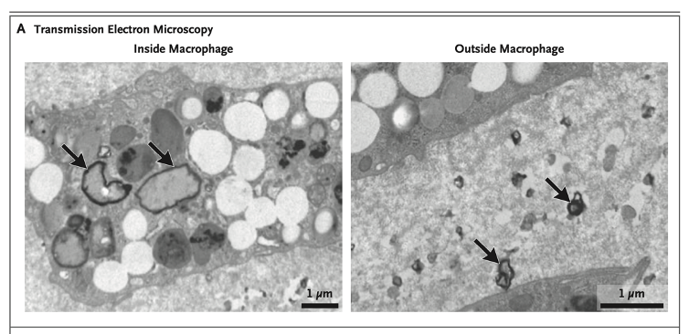

Slide 30
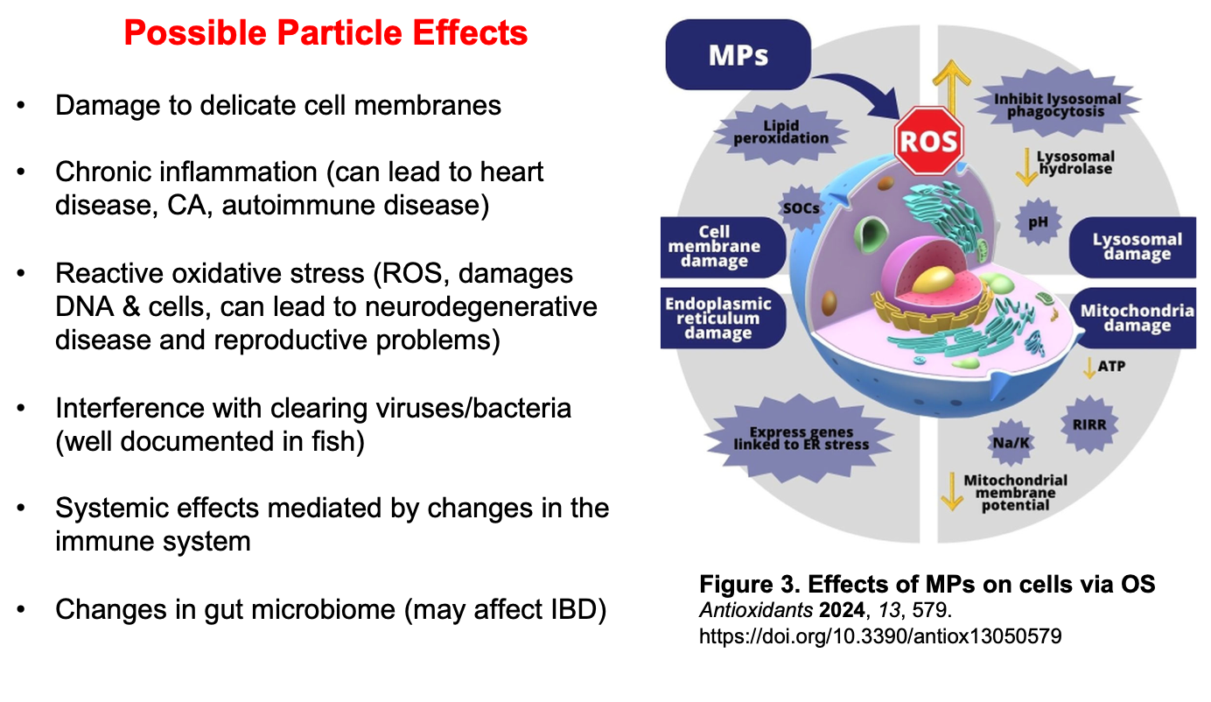

“Toxic Trespass”
Notes:
Even if plastic were completely inert, they probably shouldn’t be lying around in or next to our cells. Or, to put that more scientifically, the mere physical presence of particles is speculated to affect function at the cellular, organ and systemic levels.
Researchers refer to this as “toxic trespass.”
Micro plastics contribute to various harmful effects, including DNA damage, cell membrane breakages, mitochondrial dysfunction, inflammation, and apoptosis. Numerous studies suggest that oxidative stress [OS] may play a role in the harm caused by microplastics.
When plastic particles are are absorbed, the integrity of the cell membrane is compromised, the lipid bilayer is altered, pores form, and ultimately the cell will release of pro-inflammatory cytokines. The result is cell damage.

Slide 32


Slide 33


Researchers have identified 16,325 chemicals in plastics.
March 2024
Notes:
26% are known to be hazardous or toxic
Most—66%-- have not been tested for safety.
less than 1% of which are known to be “non hazardous.”
Yet there is little oversight of chemicals in plastics—the report found that less than 6% of these are regulated.

Slide 34


WHAT IS PLASTIC?
Polymer Backbone:
Carbon-Carbon Bonds
Multiple Chemical Additives. Many are highly toxic
Phthalates, Bisphenols, PFAS, Brominated
Flame Retardants
Slide by Philip Landrigan, M.D.
Notes:
The strength of plastics comes from their polymer backbone, which is comprised of carbon-carbon bonds.
Their versatility comes from the many chemicals added to this structure during manufacture. These additives give plastics their stability, color, flexibility, and so on. It takes so many of them to do this that any given plastic item is about 50% plastic, 50% chemical, molecularly.
A very great number of these plasticizers are bad for living cells.
Plastic are made using more than 16,000 chemicals and over 3200 are considered “substances of concern.” This is not in dispute.

Slide 35

Notes:
If you take away just one thing from this lecture, let it be this: not eat anything that is cooked or microwaved in plastic. When the molecules heat up, the chemical additives will migrate into the food.

Slide 36


Slide 37

The crux of the problem
“Because [chemicals] are locked up in fragments of microplastic, they are lasting for longer in the environment and getting into more places than they otherwise would.”
Christos Symeonides, MD
Notes:
Christos: “Plastics lock away chemicals in a way that they would never be locked away. Chemical that wouldn’t be persistent, and wouldn’t be able to travel from one side of the globe to another in the atmosphere or in the oceans — because they are locked up in the fragments of microplastic — they are lasting for longer in the environment and getting into more places than they otherwise would.”

Slide 38


Hormones are the signalling system that conducts the symphony of life.
Notes:
The endocrine system is a network of glands that create and release hormones. Estrogen, testosterone, melatonin, and insulin are some of the more familiar ones.
This network regulates all biological processes in the body, from conception through adulthood and into old age, including: the development of the brain and the nervous system; the growth and function of the reproductive system; and metabolism, mood, blood sugar levels, and the immune system, among others.
I’ve heard this process described in so many beautiful ways.
I’ve heard the endocrine system describe as “the master choreographer for how each organ forms in the womb.” This gives us our architecture. We can extend the metaphor and say that it also choreographs how our organs grows and responds at all later stages (i.e. our function).
If your endocrine system doesn’t function properly, neither does your body. Just think about diabetics and insulin.
When endocrine disrupting chemicals impact our bodies, they affect necessary systems throughout.
EDCs can impact the hormones that regulate our appetite and metabolism, causing obesity, diabetes, high blood pressure, and heart disease.
EDCs can cause cancers, especially breast, prostate, and testicular cancers, all of which are on the uptick.

Slide 39


Periods of Greatest Vulnerability
The timing makes the poison.
What happens in the womb doesn’t stay in the womb.
Notes:
The consequences of EDCs land most heavily on the very young.
Children are not little adults. They have an increased metabolic rate. Their caloric intake in proportion to their body mass is greater than for adults. They are still laying down developmental pathways.
Infants in the womb are exposed to plastics chemicals through maternal exposure during pregnancy.
Developing fetuses are especially at risk. In the early weeks of pregnancy, hormones are guiding everything – we have no other system. So tiny doses of EDCs can send development in many ways.

Slide 40

Placenta Studies
The placentas from 43 pregnant women were examined for microplastics.
13 pregnancies had been complicated by fetal growth restriction
  Microplastics were found in all.
  Microplastics were also associated lower newborn assessment scores.
Of the 30 normal pregnancies, microplastics were found in only 3.
Amereh et al. Placental plastics in young women from general population correlate with reduced foetal growth in IUGR pregnancies. Environ Pollut. 2022 Dec 1;314:120174.
Slide by Chris Mauck, MD

Slide 41

Altered epigenetic programming occurred in the prostate gland due to chemical exposure.
Tissue around the urethra became so constricted that the mouse could barely pee.
Necrotic kidneys
Bladder on the point of exploding.

Slide 42

EDCs can be obesogens
Can disrupt lipid metabolism
Linked to:
  Insulin resistance and increase in risk of diabetes
  Hypercholesterolemia
  Cardiovascular disease, and stroke
Notes:
Obesogens disrupt the system’s metabolism, potentially affecting the body’s ability to maintain a stable energy balance. This can occur both before and after birth.
CLICK
In the case of PFAS, we have abundant evidence of metabolic impacts.
READ SLIDE

Slide 43

Prenatal Dose:
1 part per billion
9-16 days gestation
“generational toxicity”
Newbold, RR, et al. "Developmental exposure to endocrine disruptors and the obesity epidemic." Reproductive toxicology 23.3 (2007): 290-296.
Notes:
Here is an example from the laboratory.
Of these two mice, the mother of the obese mouse was exposed to DES, a well-known endocrine disrupting chemical at a very specific interval while pregnant – albeit in a very small dose. Though the two mice received the same caloric intake and had the same amount of activity, the one exposed to an EDC during the 9-16 day gestation interval became obese. The offspring of mother mice dosed with the same amount of DES at different points in the pregnancies did not become obese.
After the first generation experienced obesity, a disproportionate number of the next generation experienced it as well, and so on down the line. This is called an epigenetic effect. An outside influence changed the way that the genes of the animal were expressed.

Slide 44

Artist: ThisCityMaps
Notes:
EDCs can disrupt brain development, leading to lower IQ, ADHD, and autism-spectrum disorders. This occurs because of the incredible complexity how our brains grow. Imagine the brain cells growing like a subway system being built. Over the course of pregnancy, neural cells divide and multiply very quickly. As they are dividing and multiplying, neurons migrate from the positions where they are formed to their final destinations. They form dense networks of connections with one another while they are doing this, and each connection must be precisely established. All of it is highly interdependent. If it doesn’t function properly, signals don’t reach their intended destinations in the necessary way – like the A train and the 1 train not intersecting.
It’s a beautiful and amazing process, but it results in what scientists refer to as an “exquisite vulnerability” – which is unparalleled in adults. If you think you’ve seen an uptick in neurodevelopmental disorders in recent years, you aren’t mistaken.

Slide 45

Notes:
A series of researchers, including Shanna Swan, an environmental and reproductive epidemiologist at Mt. Sinai Medical School, have been keeping an eye on human sperm counts over the decades, and are on to some alarming trends.
Sperm counts dropped nearly 50% between 1938 and 1990, a period during which testicular cancer jumped sharply. The rate of decline is currently accelerating.

Slide 46

Chronic disease is increasing
Notes:
we can’t say that this is from any evolutionary changes. It has to be from environmental influences when the change is seen that quickly.

Slide 47


Slide 48

How do we solve this?
Artwork by Javier Jean, 2023

Slide 49



Tell patients to avoid plastics (and teflon) in food handling

Slide 50



And infant care.

Slide 51



And textiles in close proximity for long periods
(especially indoors)

Slide 52



Recommend reverse osmosis water filters
Countertop
$120 - $510
Under Sink
$150 - $800
Whole House
$10,000 - $16,000

Slide 53
Regulatory systems are the most efficient and the most just.

Slide 54

2025 Polling by Oceana:
81% of U.S. voters support reducing the amount of plastic that is produced.
78% of U.S. voters support national policies that reduce single-use plastic foam.
85% of U.S. voters support increasing the use of reusable packaging and foodware.

Slide 55


Slide 56


Slide 57


Slide 58
You can join this fight.
Notes:
You can join this fight. Healthcare personnel are regularly needed to testify to local legislatures and write letters to the editor supporting such bans.

Slide 59


Thank you!!
megan@psnap.org
www.psnap.org

Slide 60
Why is this happening
now?

Slide 61

Notes:
2024 was the hottest year known to science, with four days in July that were the hottest in 125,000 years.
Global temperatures between June and August were 1.5 degrees Celsius (2.7 degrees Fahrenheit) above the preindustrial average. That is, we are now living on a planet that is warmer than the human species evolved to inhabit.
Even the petrochemical industry understands that it has an image problem.

Slide 62

Notes:
The increasing popularity of electric cars and renewable energy are reducing demand for fossil fuels.
Globally, 20% of new car sales were EVs in 2023.
Renewables produced 30% of the world’s electricity in 2023. We’ve reached a ‘pivot point’ where emissions from fossil fuels for power generation will start to fall.
According to the International Energy Agency, renewables are set to overtake coal and become the world's largest source of electricity by early 2025.

Slide 63

PLAN A
PLAN B

Slide 64

British Petroleum expects plastic to account for 95% of growth in oil demand
Source: British Petroleum, Carbon Tracker Estimates

Slide 65

Plastic production is a climate problem.
Plastic is responsible for over 5% of all greenhouse gas emissions.

Slide 66


Amount of Fossil Fuel required…
To make a plastic bottle.
To transport it to market.
Images by Houston Diaz

Slide 67

If plastic were a country, it would be the world’s fifth largest greenhouse gas emitter, just ahead of Brazil.
Notes:
In 2015, plastics accounted for 3.7% of global emissions.

Slide 68

Decarbonizing the power grid will not be enough to reach climate goals if we continue to produce plastics as we now do.

Slide 69


